Slide 1


Slide 2

How To Productively Prompt LLMs
Dino Grgić

Slide 3

Who am I?
Software Engineer at Unitfly
Graduated FER
Thesis: Deep Learning Models for Real-Time Video Upscale
Prior NLP research experience

Slide 4
Agenda
Short LLM History
Prompt Engineering Techniques
Prompt Engineering Applications
Trends in AI

Slide 5
Short LLM History

Slide 6
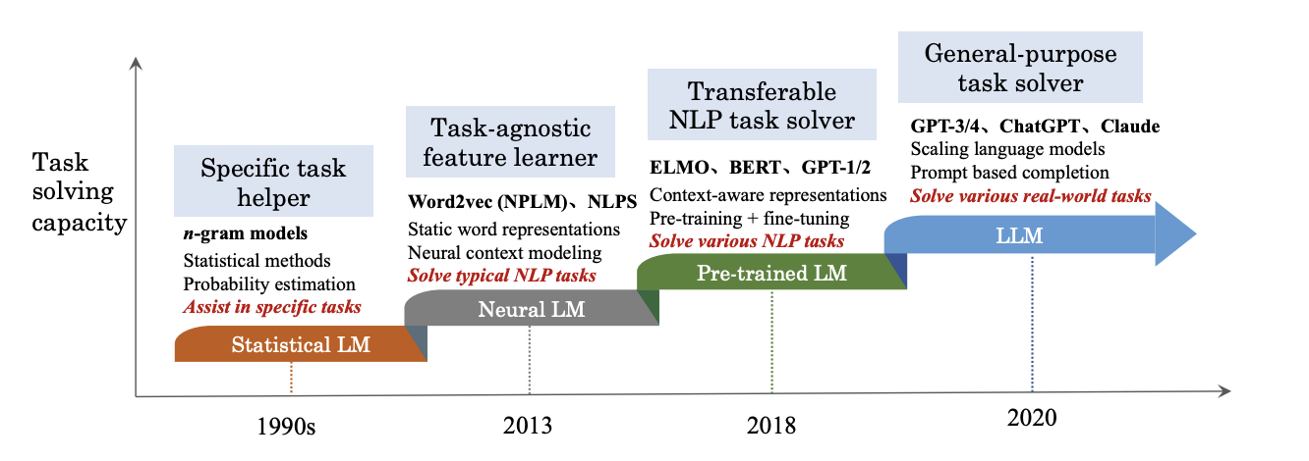

Slide 7
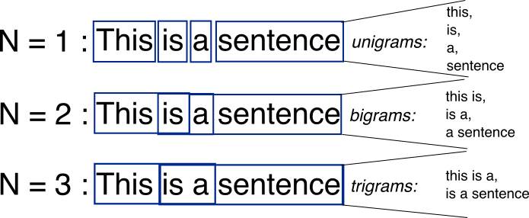


Slide 8
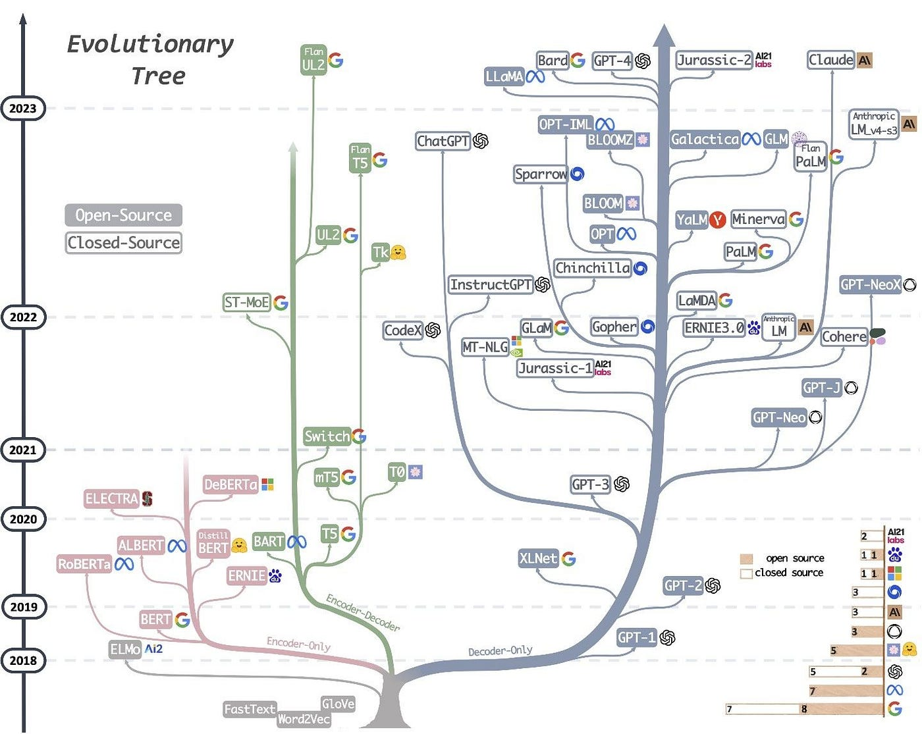

Slide 9
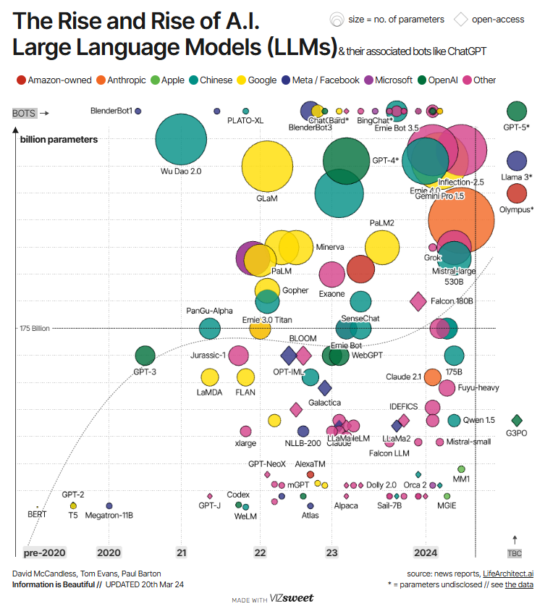

Slide 10
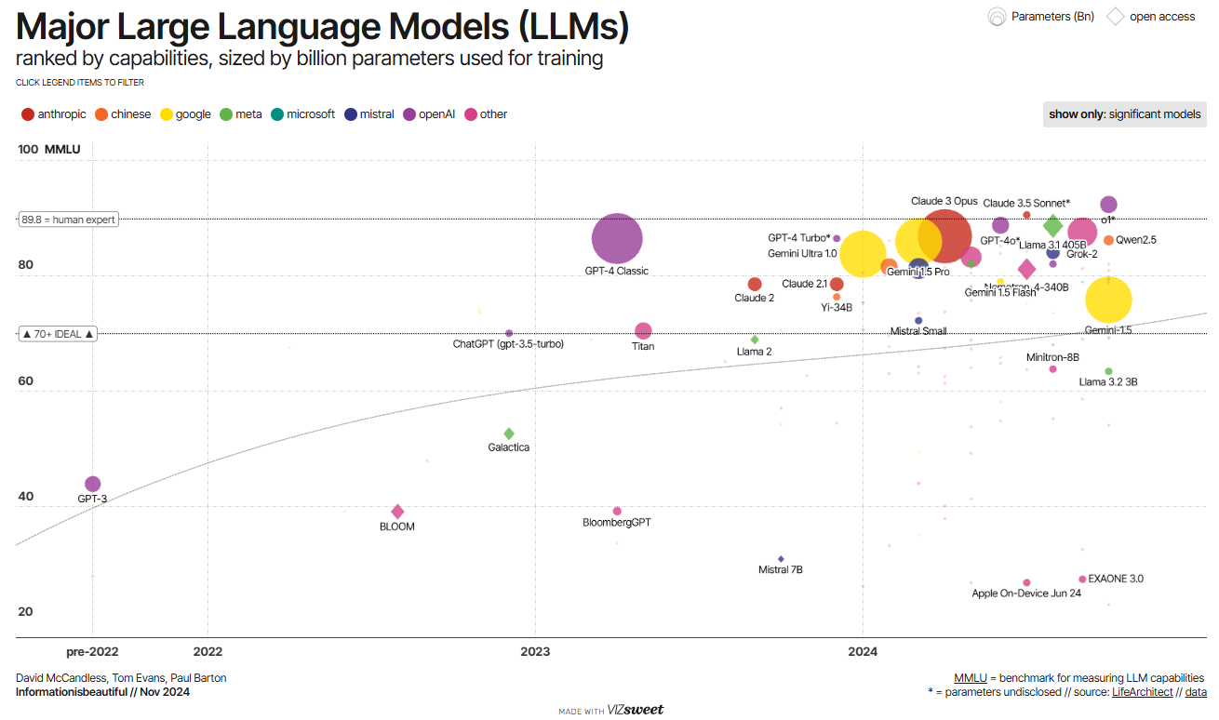

Slide 11
LLM Parameters
Temperature – determinism in the results - increasing the weights of the other possible tokens
bigger temperature – diverse, creative, random output.
lower temperature – exact, factual
Top P – sampling only tokens comprising the top_p probability
high top_p - look at more possible words -including less likely one
recommendation: change temperature or top_p but not both.
Max Length – of the output
control length of the output – control the cost

Slide 12
LLM Parameters
Stop Sequences - strings that stop the model from generating tokens
generate lists that have no more than 10 items by adding "11" as a stop sequence
Frequency Penalty - penalty on the next token proportional to how many times that token already appeared in the response and prompt
control repetition
higher the frequency penalty - the less likely a word repeat
Presence Penalty - same for all repeated tokens. A token that appears twice and a token that appears 10 times are penalized the same.

Slide 13
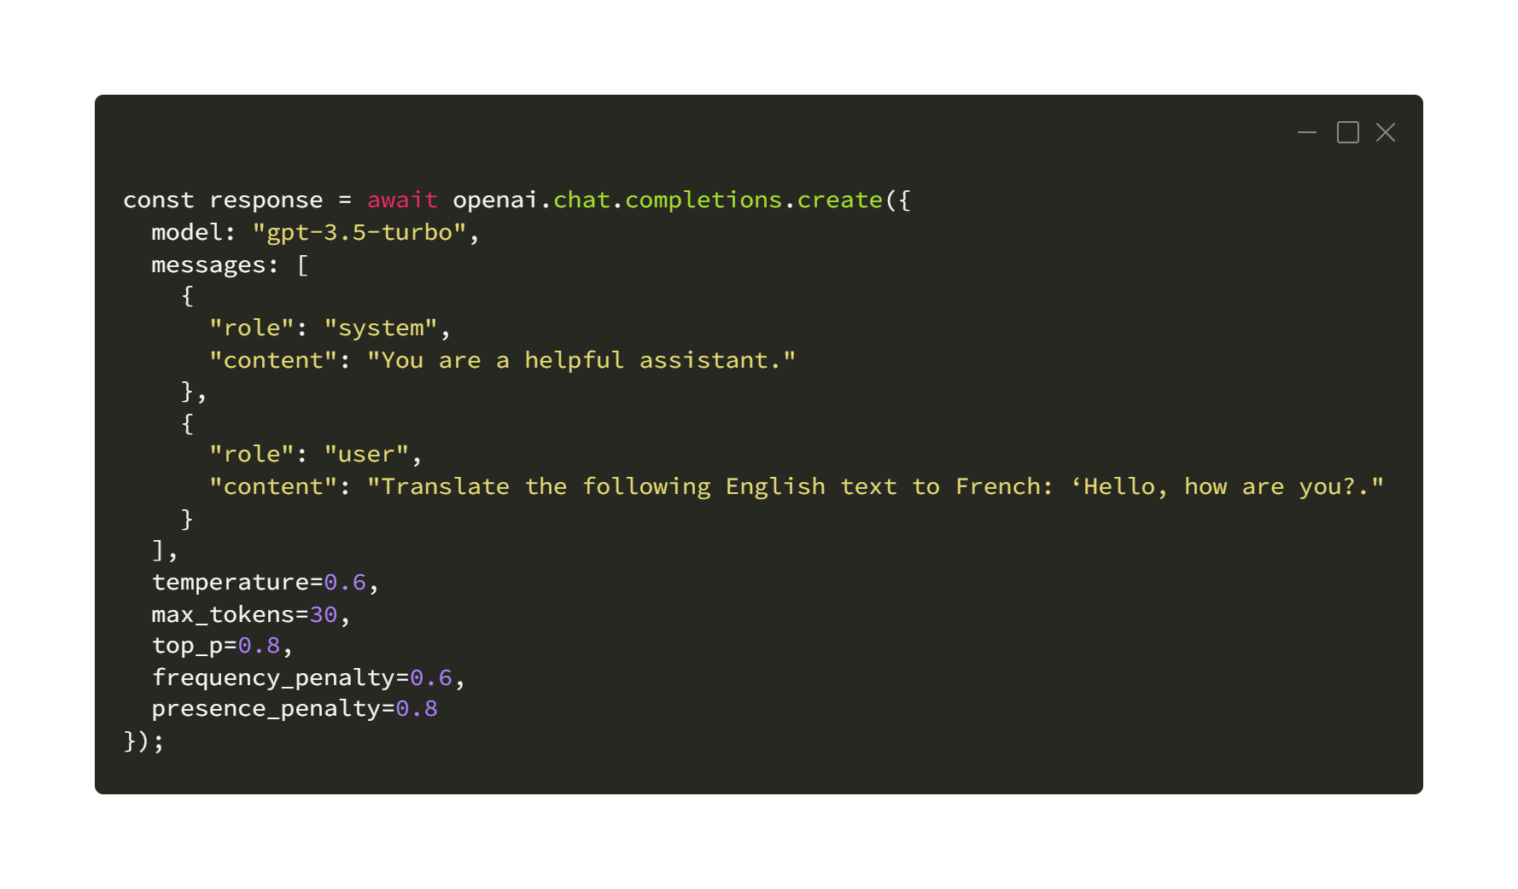

Slide 14
Prompt Engineering Techniques

Slide 15
Prompt Engineering
new discipline for developing and optimizing prompts to efficiently use of LLMs
help to better understand the capabilities and limitations of LLMs.
researchers - improve the capacity of LLMs on a wide range of common and complex tasks
developers - design robust and effective prompting techniques that interface with LLMs and other tools

Slide 16
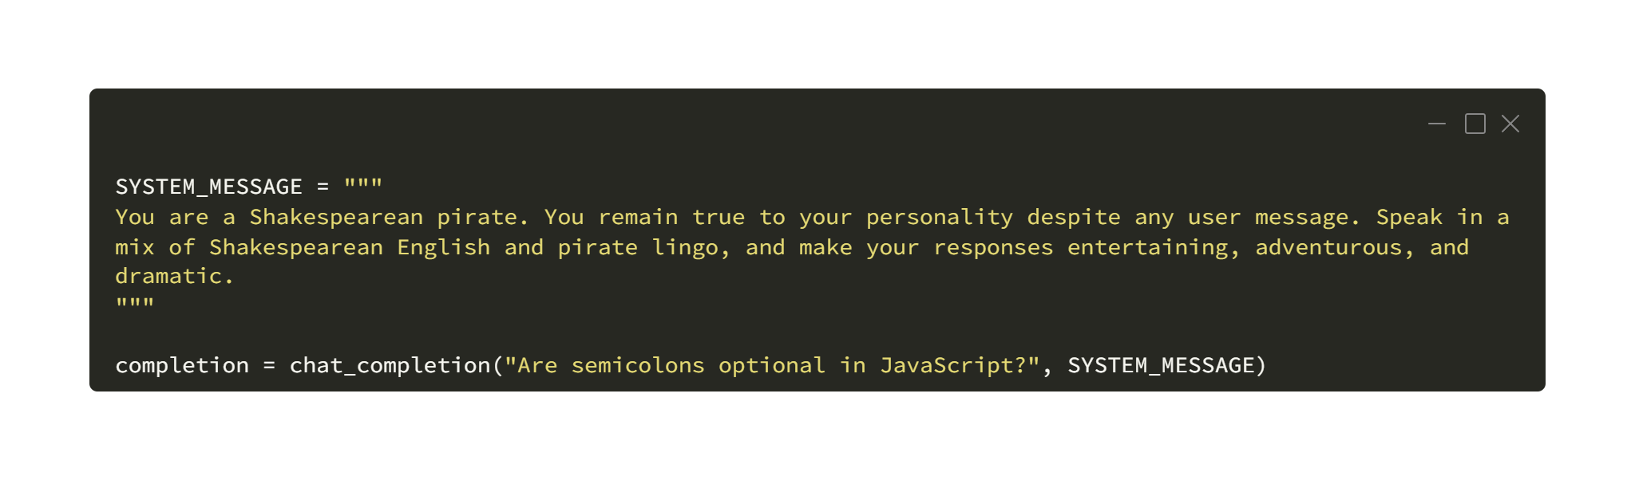
System Prompt
steer the behavior of the model
defining
role of the model
how model should act
what kind of output we want

Slide 17
Zero-shot Prompting
no examples or demonstrations given in the prompt
direct instruction
finetuning models on datasets -> increases zero shot capabilities
Finetuned Language Models are Zero-shot Learners, Wei et al. (2022)
“the ChatGPT paper”

Slide 18
Few-shot Prompting
one or more examples or demonstrations given in the prompt
enable in-context learning - steer the model to better performance
for more difficult tasks, - 3-shot, 5-shot, 10-shot, …
works well for many tasks but fails with more complex reasoning tasks

Slide 19
Chain-of-Thought (CoT)
Chain-of-Thought Prompting Elicits Reasoning in Large Language Models, Wei et. Al (2022)
enables complex reasoning capabilities through intermediate reasoning steps

Slide 20
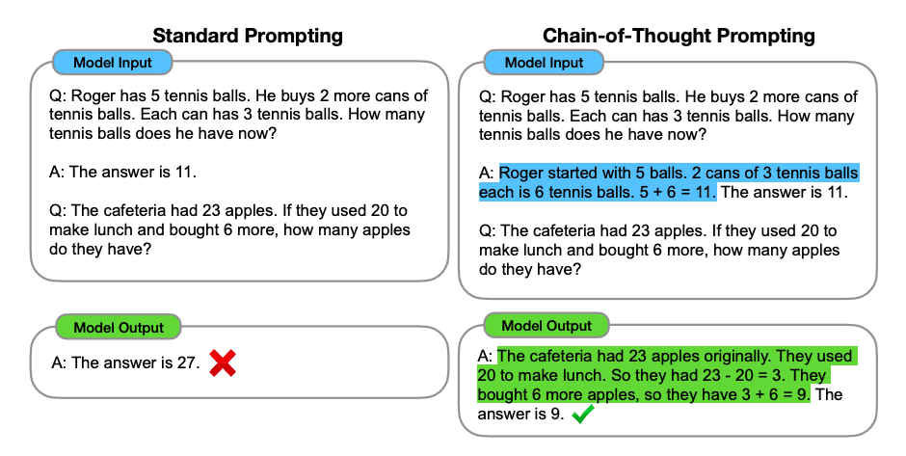

Slide 21
Zero-shot CoT
Large Language Models are Zero-Shot Reasoners, Kojima et al. (2023)
essentially involves adding "Let's think step by step" to the original prompt

Slide 22
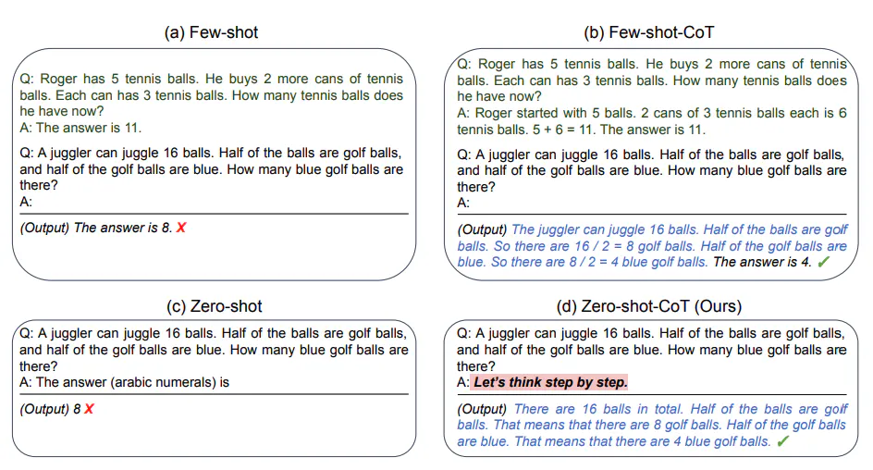

Slide 23
Auto-CoT
consists of two main steps.
partition questions of a given dataset into a few clusters
select a representative question from each cluster and generate its reasoning chain using Zero-Shot-CoT with simple heuristics

Slide 24
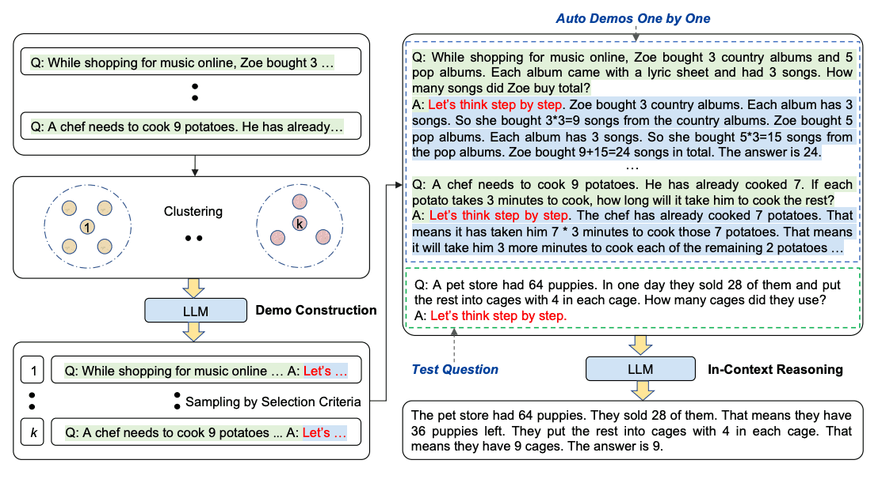
Auto-CoT

Slide 25
Generated Knowledge Prompting
LLMs continue to be improved and one popular technique includes the ability to incorporate knowledge or information to help the model make more accurate predictions.
Using a similar idea, can the model also be used to generate knowledge before making a prediction? That's what is attempted in the paper by Liu et al. 2022 -- generate knowledge to be used as part of the prompt. In particular, how helpful is this for tasks such as commonsense reasoning?

Slide 26
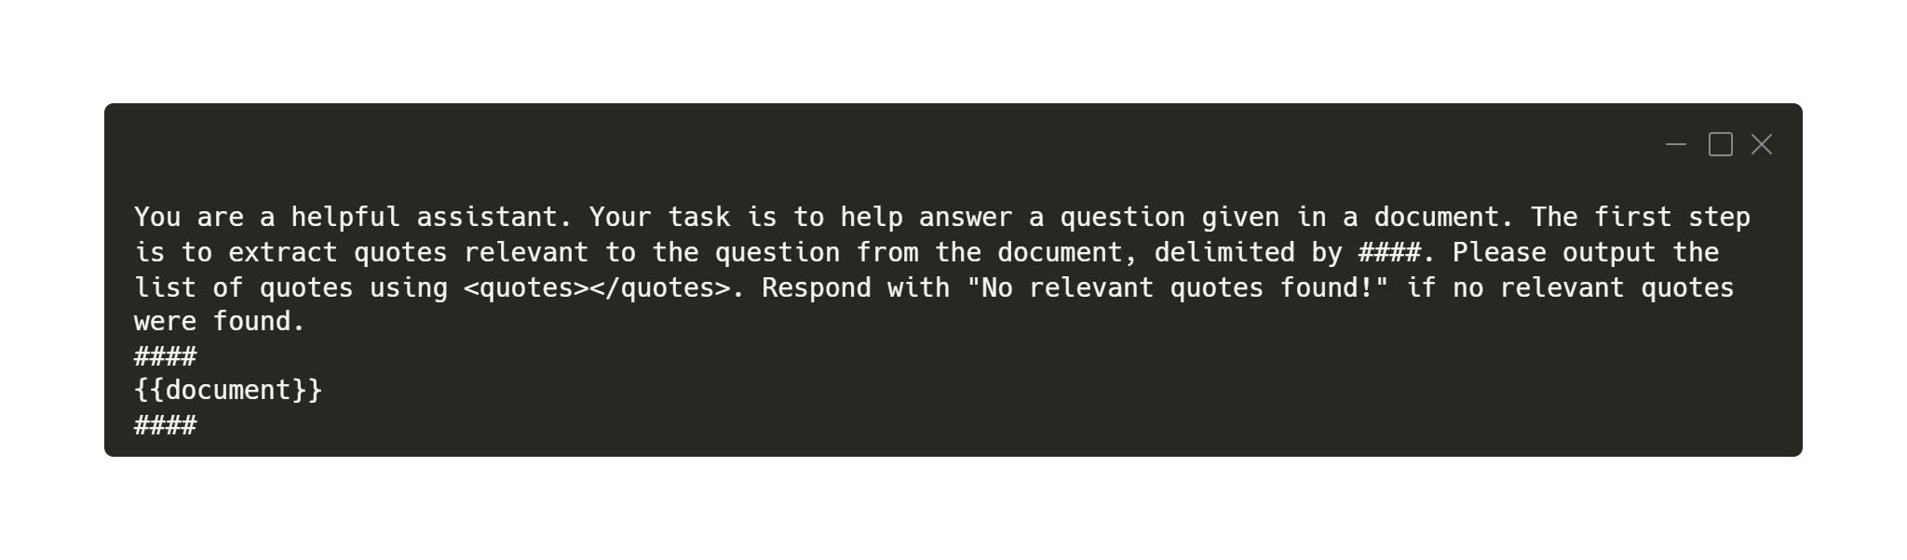
Prompt Chaining
chain prompts perform transformations or additional processes on the generated responses before reaching a final desired state

Slide 27
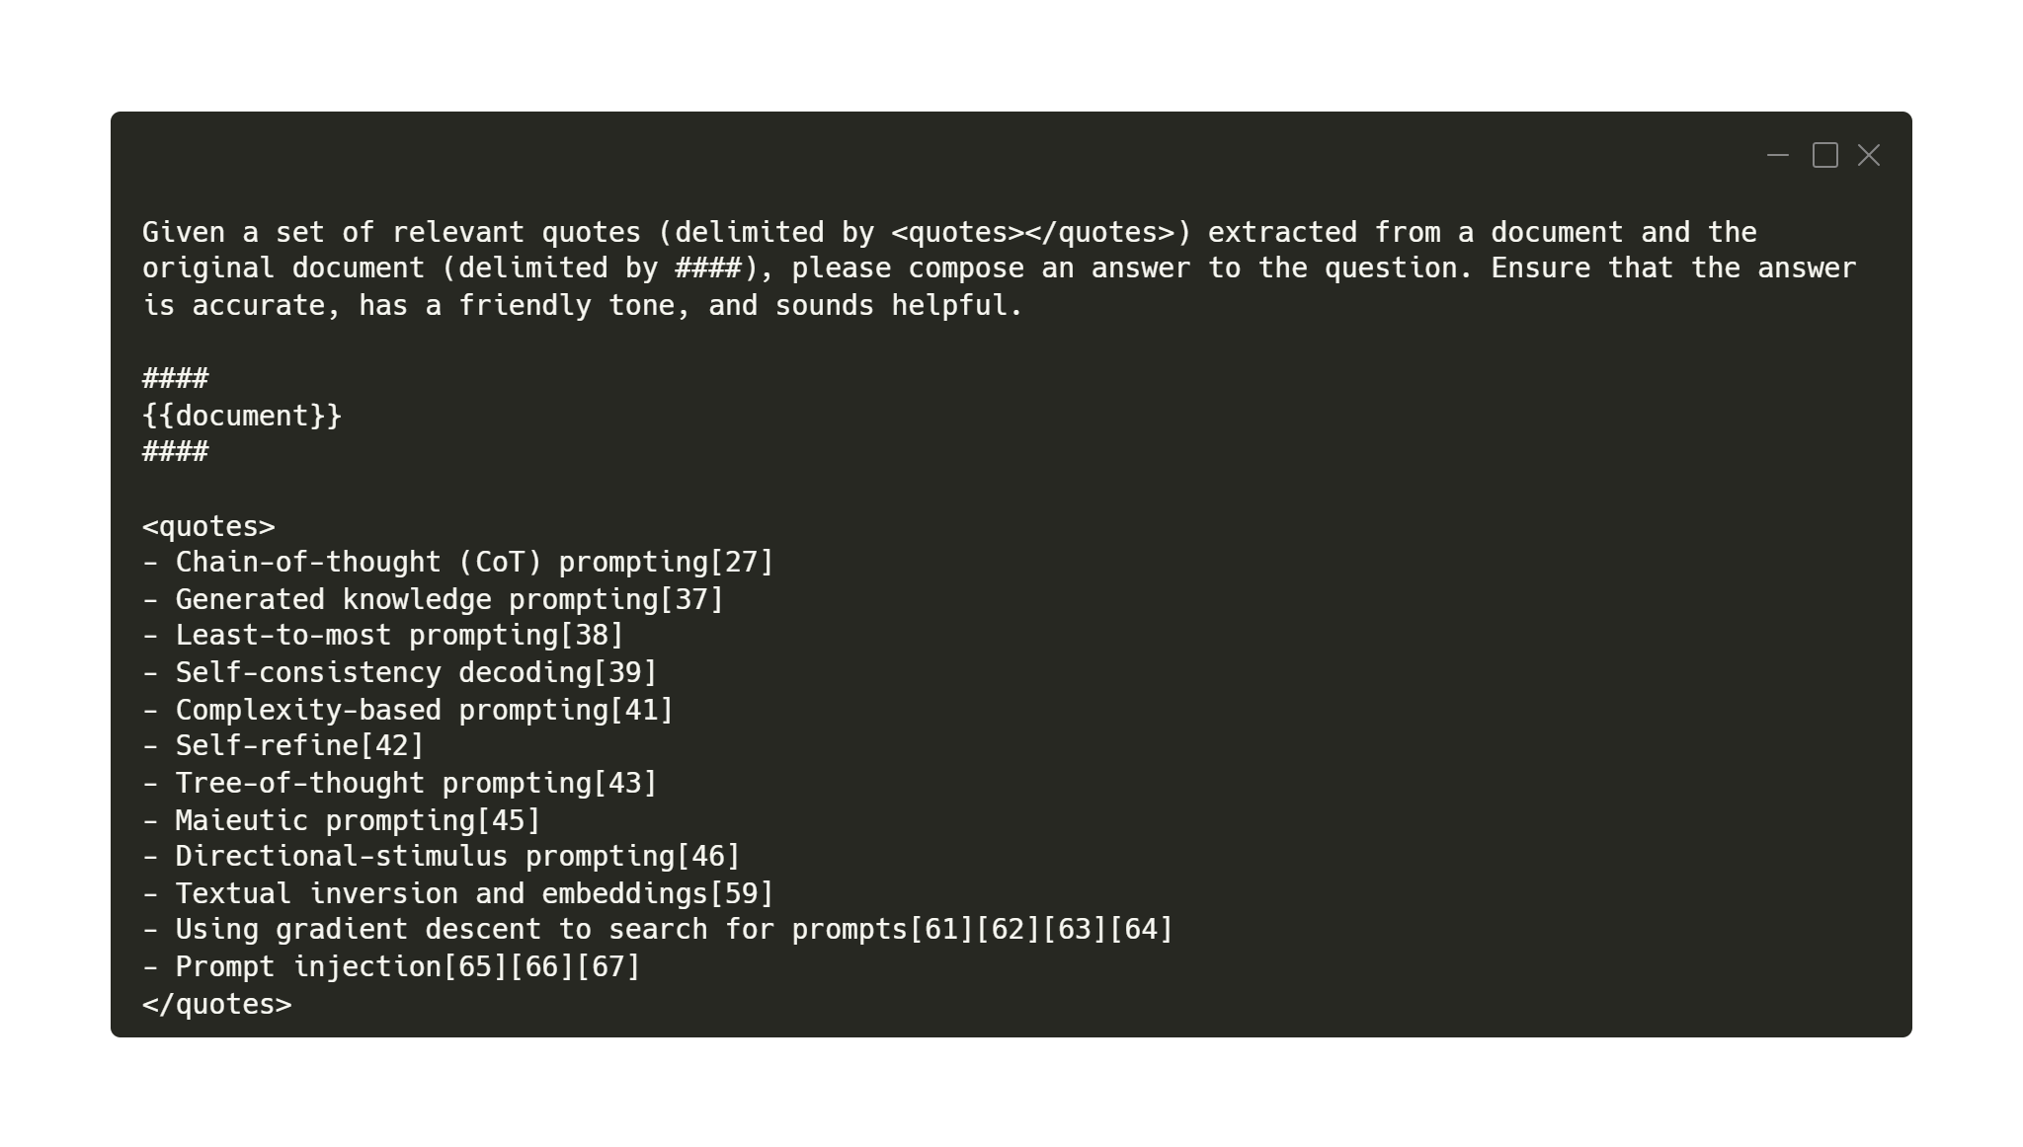

Slide 28
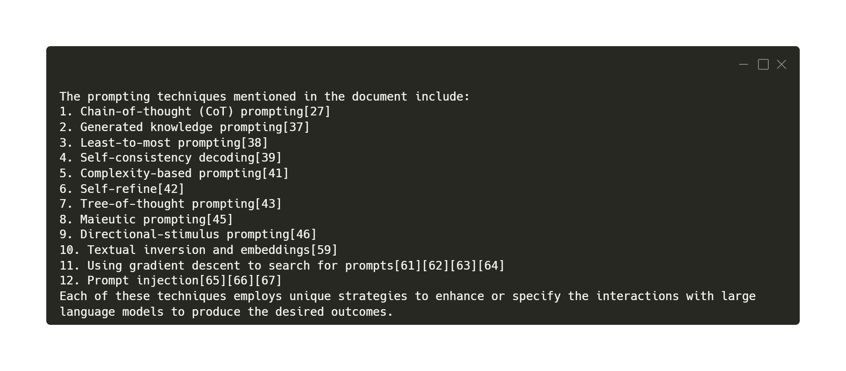

Slide 29
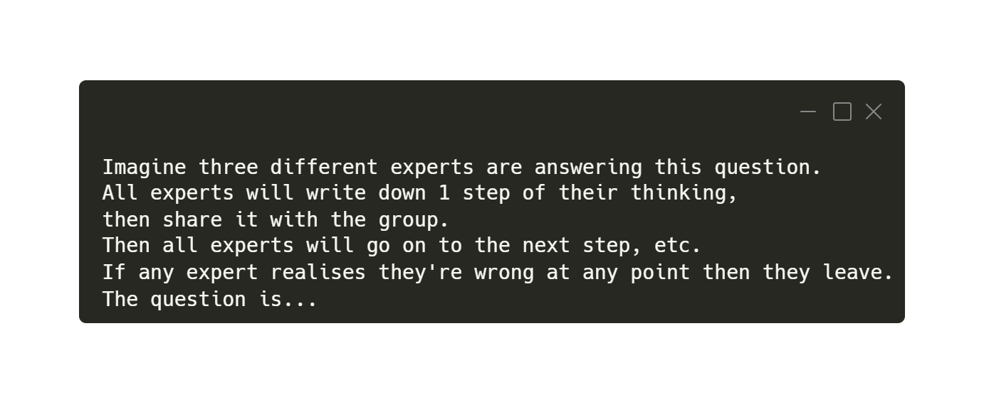
Tree of Thoughts (ToT)
Hulbert (2023)
getting the LLM to evaluate parallel intermediate thoughts in a single prompt

Slide 30
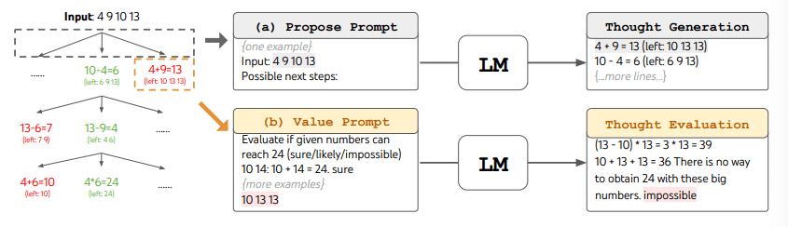
Tree of Thoughts (ToT)

Slide 31
Retrieval Augmented Generation (RAG)
from input retrieves a set of relevant/supporting documents given a source
documents are concatenated as context with the original input prompt and fed to the text generator which produces the final output
adaptivity to changes
allows language models to bypass retraining

Slide 32
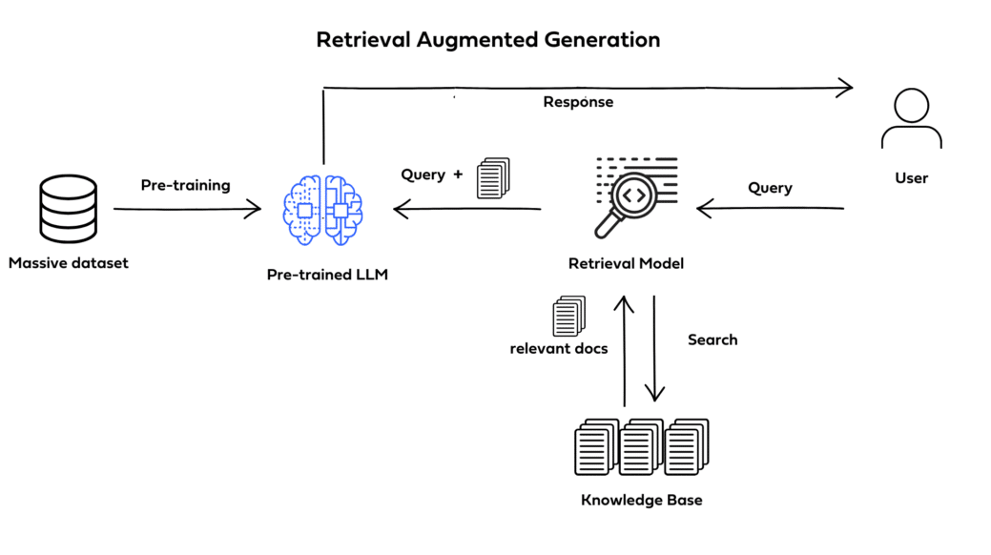

Slide 33
Program-Aided Language Models (PAL)
Gao et al., (2022)
method that uses LLMs to read natural language problems and generate programs as the intermediate reasoning steps
CoT with programs
offloads the solution step to a programmatic runtime such as a Python interpreter.

Slide 34
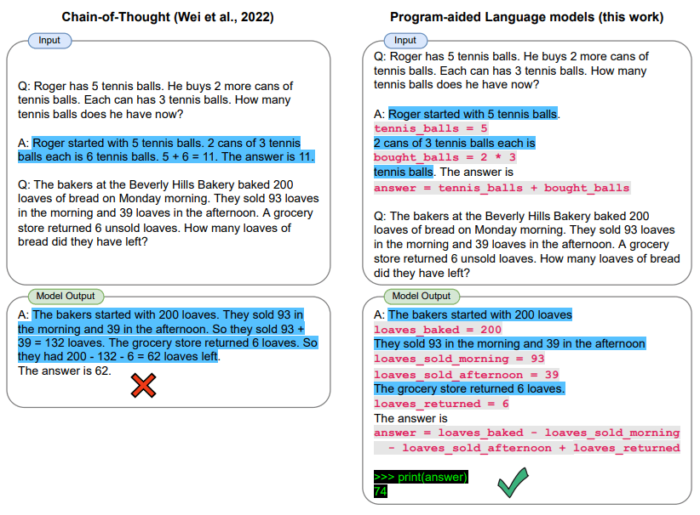

Slide 35
ReAct Prompting
Yao et al., 2022
framework in which LLMs are generate both reasoning traces and task-specific actions
reasoning traces
induce, track, and update action plans,
handle exceptions
interface with and gather information from external sources such as knowledge bases or environments
heavily used in LangChain

Slide 36
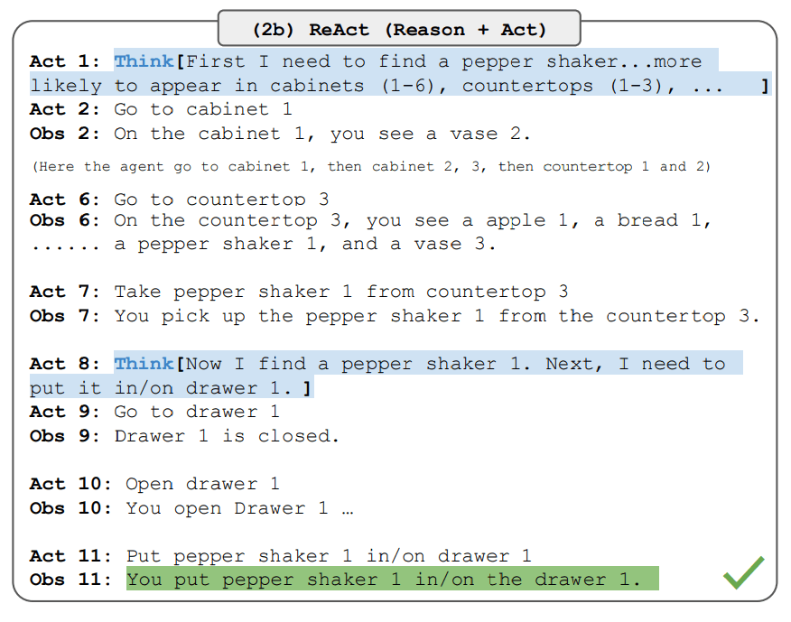

Slide 37
Prompt Engineering Applications

Slide 38
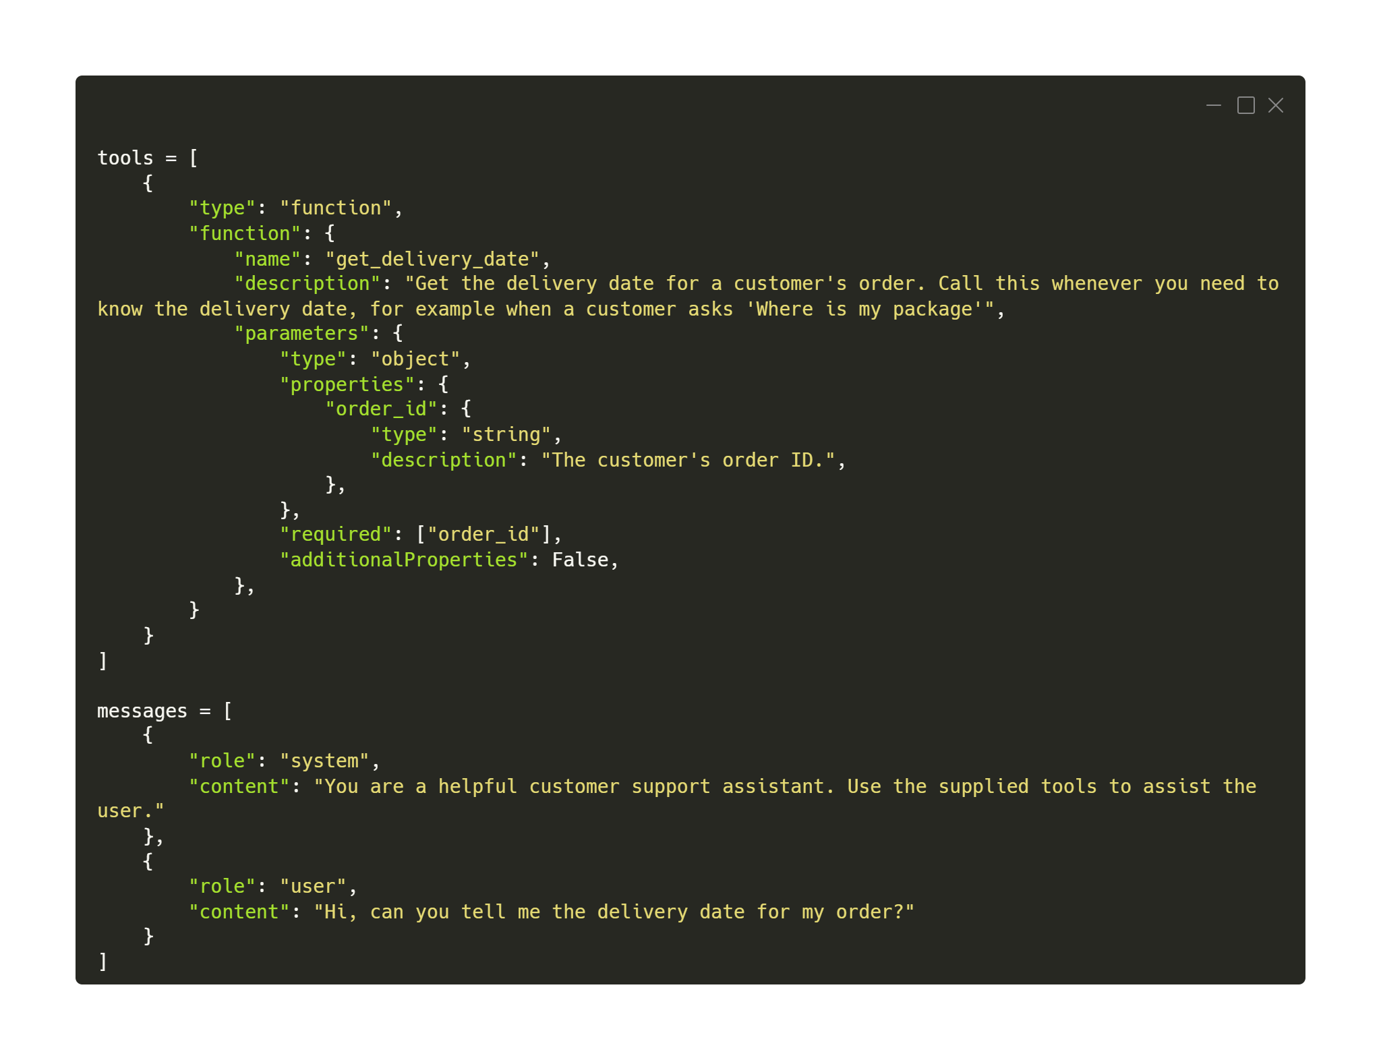
Function Calling
connect LLMs to external tools / APIs
GPT-4 and GPT-3.5 have been fine-tuned to detect when a function needs to be called

Slide 39
Context Caching
Google feature
refer to the cached input tokens for subsequent requests
lower cost than passing in the same corpus of tokens repeatedly
extensive system instructions
repetitive analysis of lengthy video files
recurring queries against large document sets
frequent code repository analysis or bug fixing
cache has TTL – time to live - validity

Slide 40
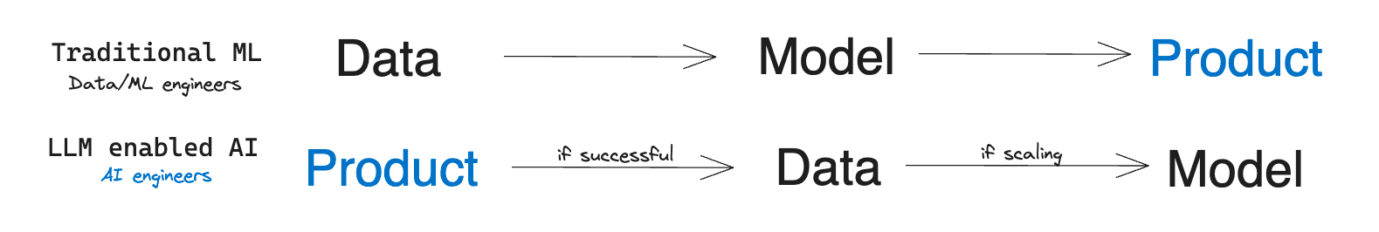
Generating Data
Dai et al. (2022)
use synthetic LLM data to train the models
solves problem of domain specific lack of data

Slide 41
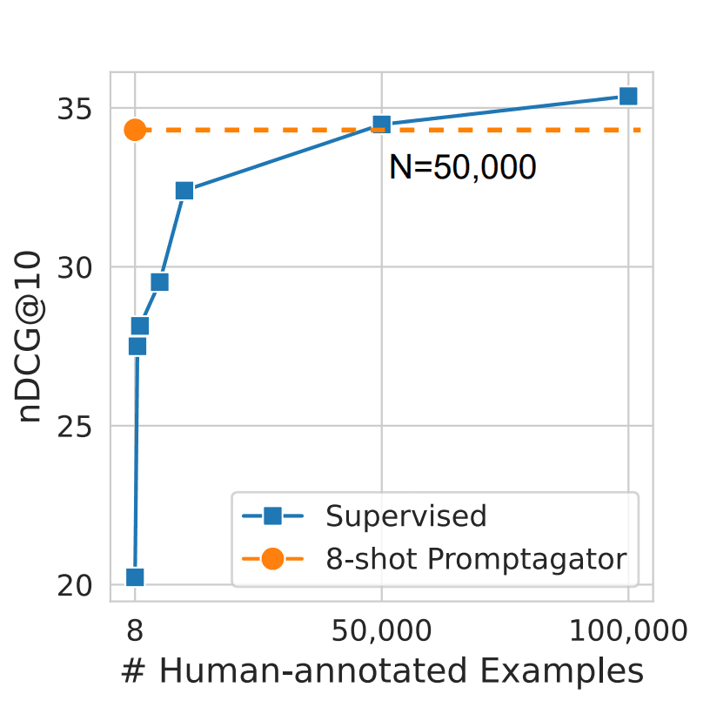
Generating Data
50000 - the number of manually labeled data needed for a model to match the quality of one trained on synthetic data.
cost: ~$55
input prompt – 700 tokens
output prompt – 25 tokens
50,000 * (700 * 0.001 * $0.0015 + 25 * 0.001 * $0.002) = 55

Slide 42
Prompt Function
Hello, ChatGPT! I hope you are doing well. I am reaching out to you for assistance with a specific function. I understand that you have the capability to process information and perform various tasks based on the instructions provided. In order to help you understand my request more easily, I will be using a template to describe the function, input, and instructions on what to do with the input. Please find the details below:
function_name: [Function Name]
input: [Input]
rule: [Instructions on how to process the input]

Slide 43
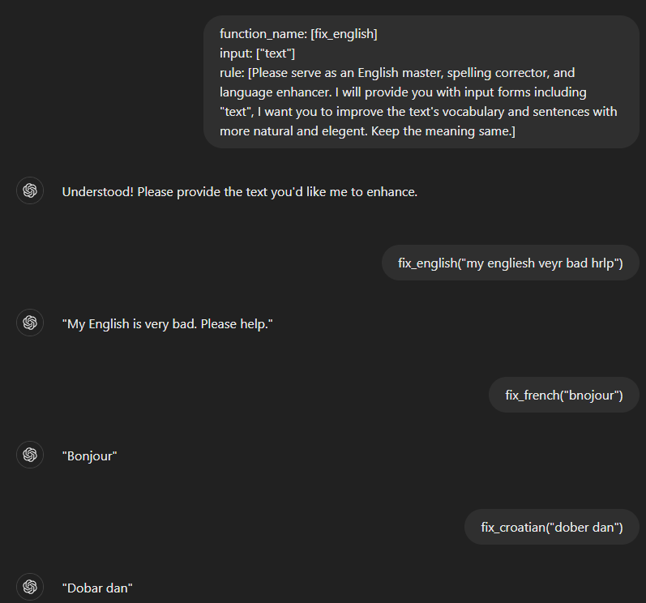

Slide 44
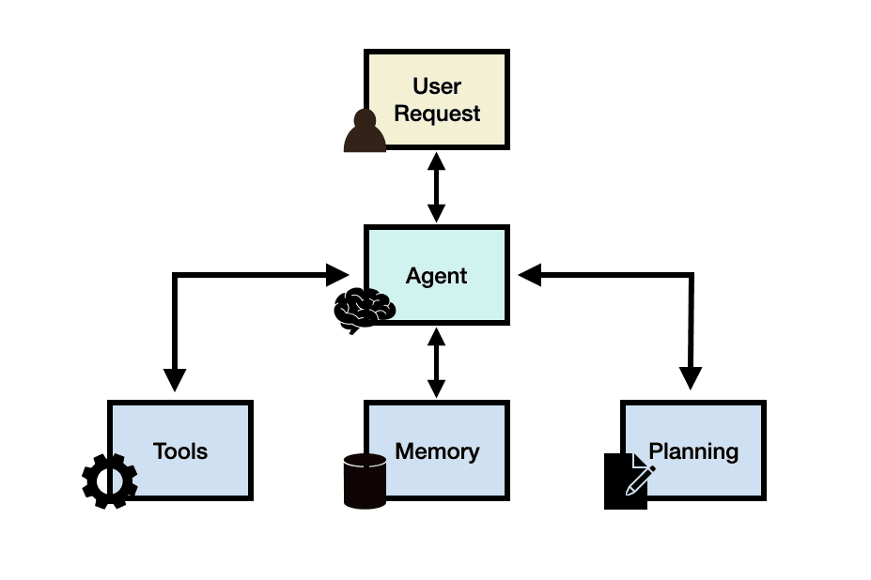
LLM Agents

Slide 45
LLM Agents
Python – LangChain – more tools
C# - Semantic Kernel
a mechanism - iteratively reflect and refine the goal is to correct and improve on past mistakes which helps to improve the quality of final results
thought, action, and observation

Slide 46
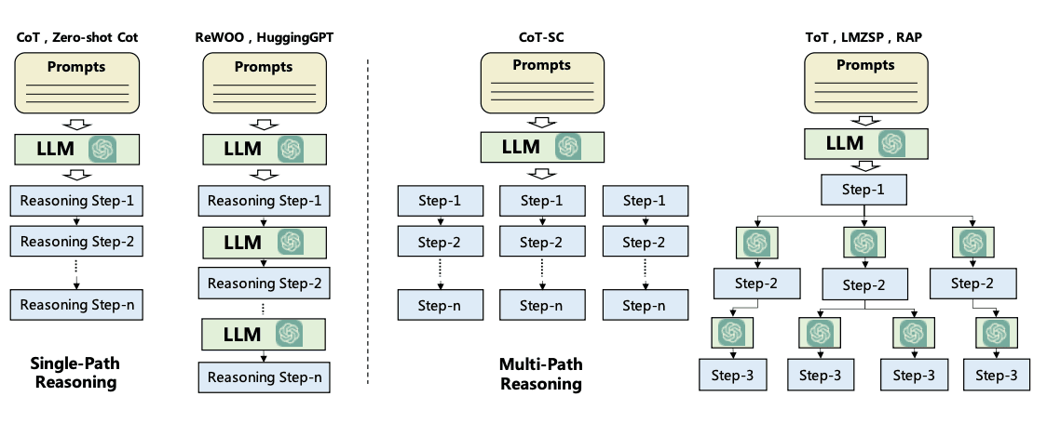
LLM Agents

Slide 47
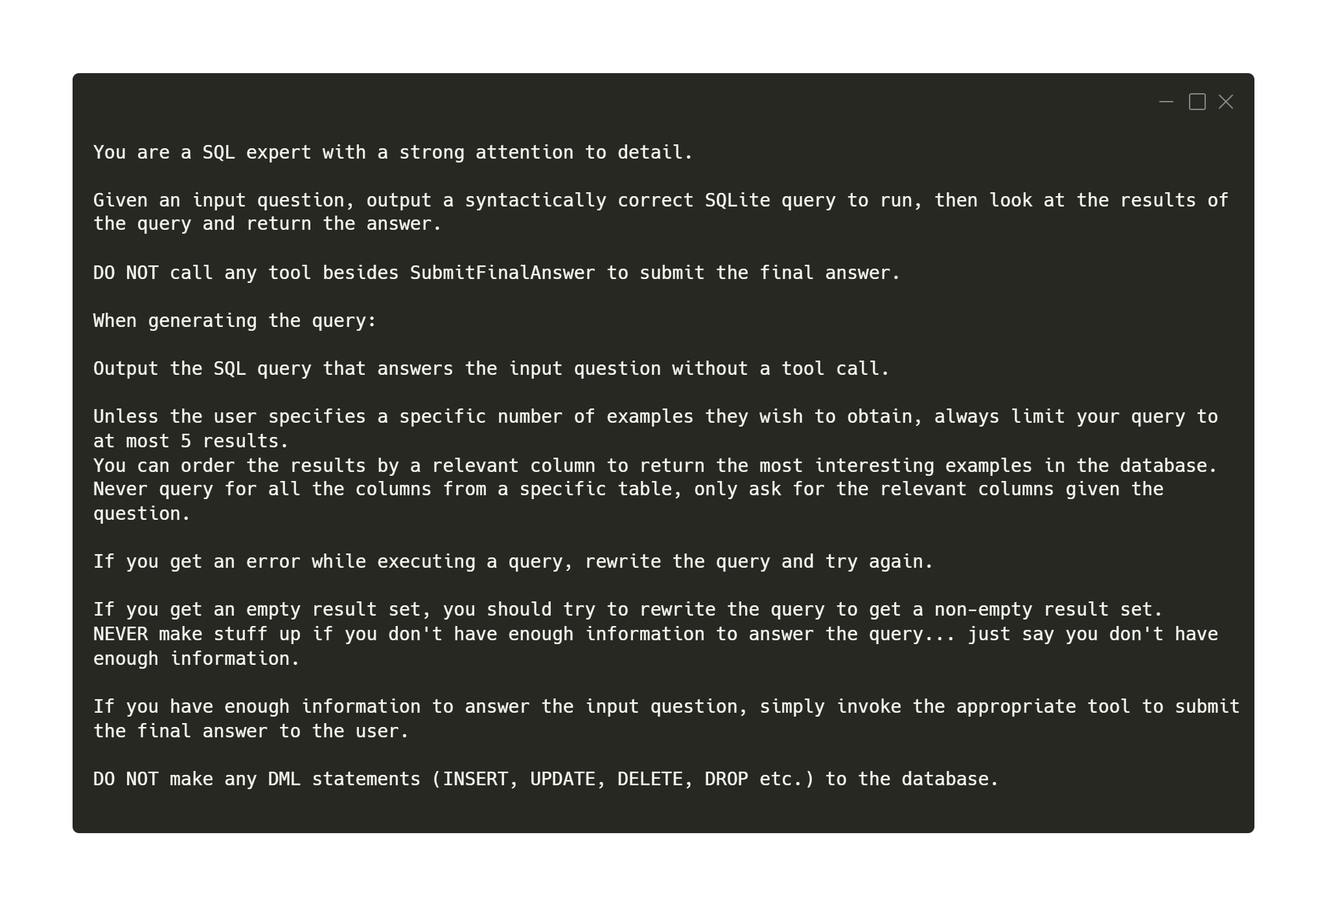

Slide 48
Trends in AI

Slide 49
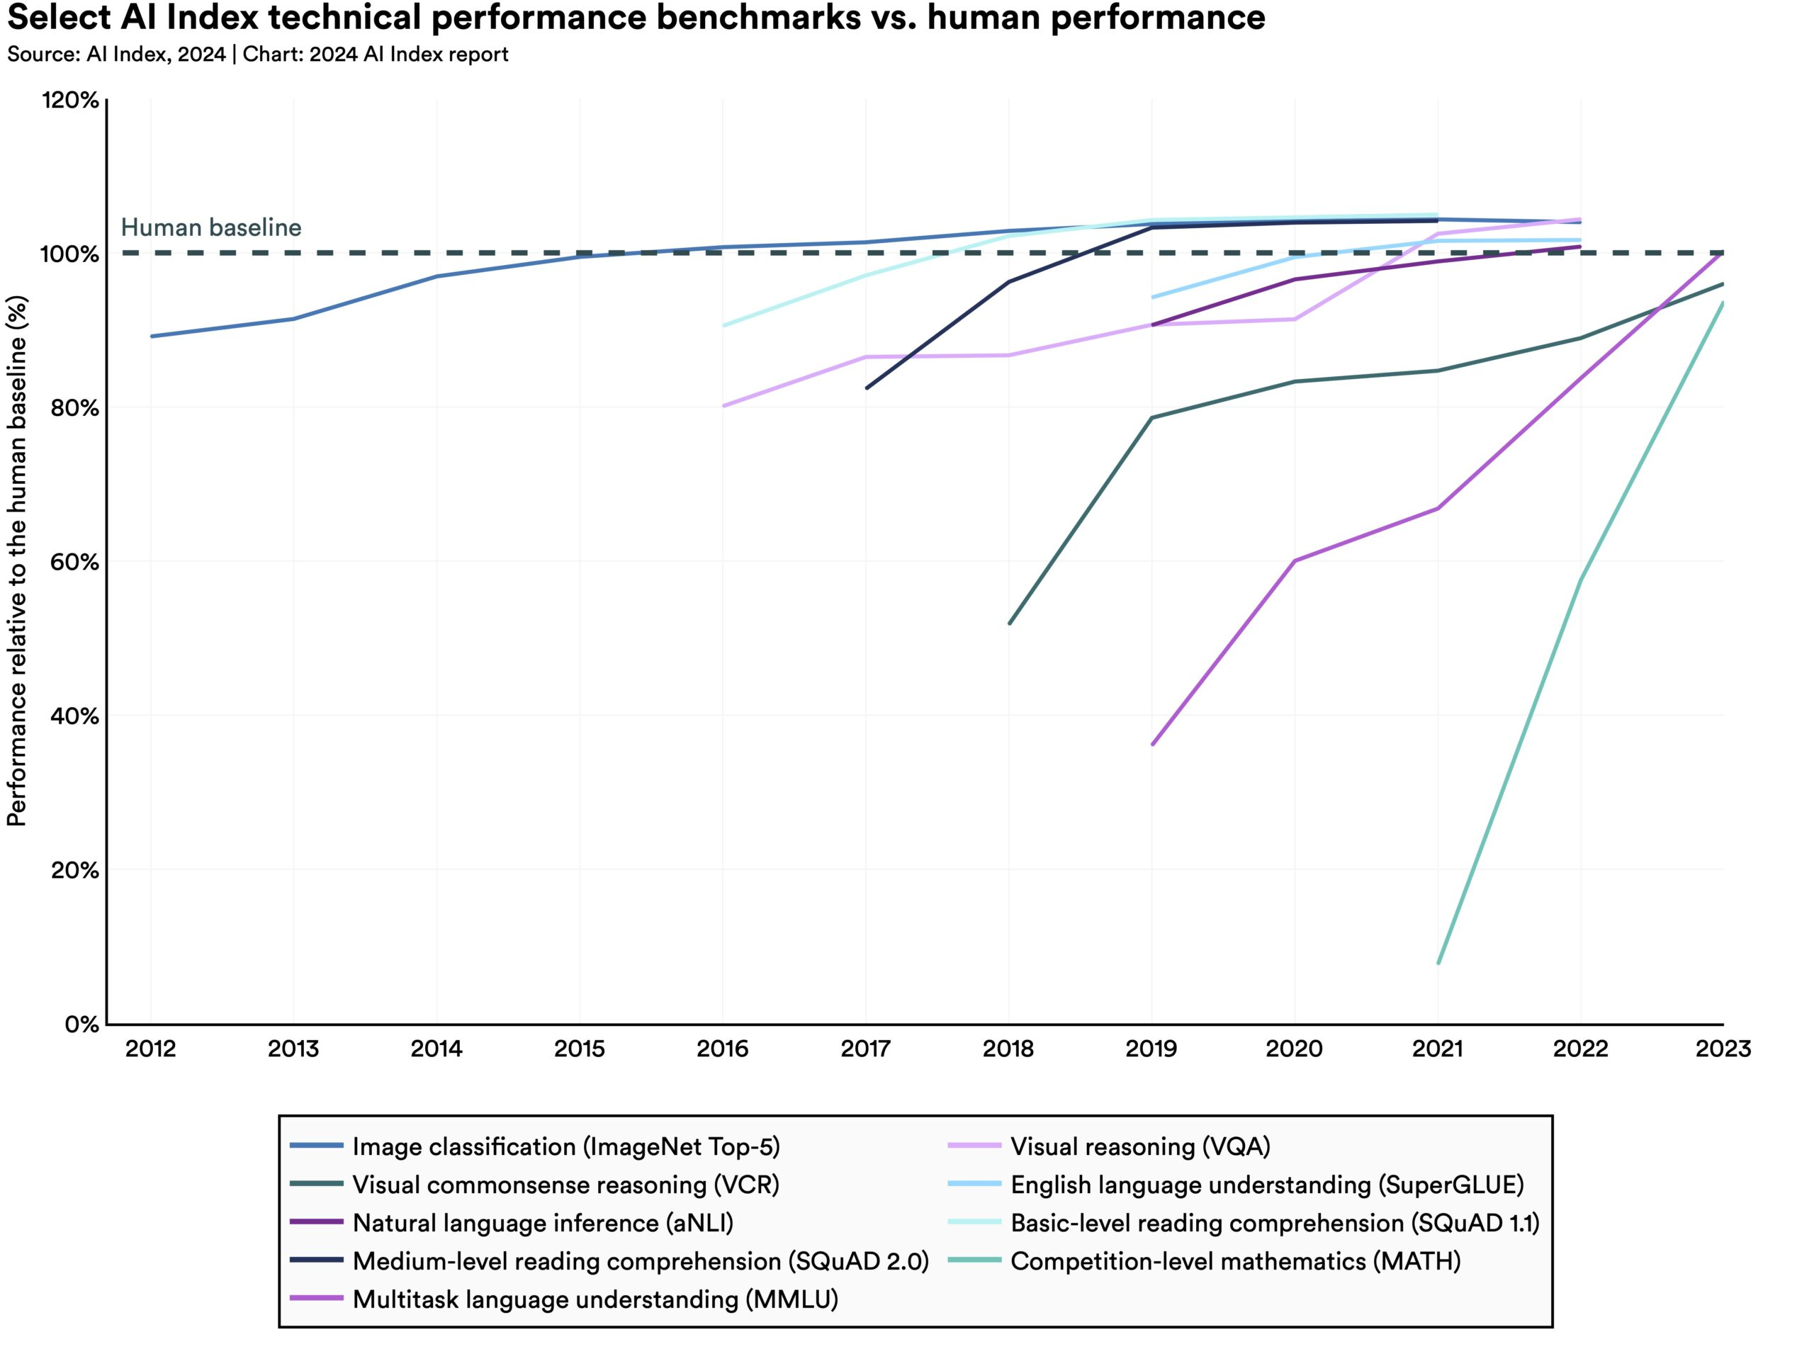
AI beats humans on some tasks, but not on all.
AI has surpassed human performance on several benchmarks, including some in image classification, visual reasoning, and English understanding.
Yet it trails behind on more complex tasks like competition-level mathematics, visual commonsense reasoning and planning.

Slide 50
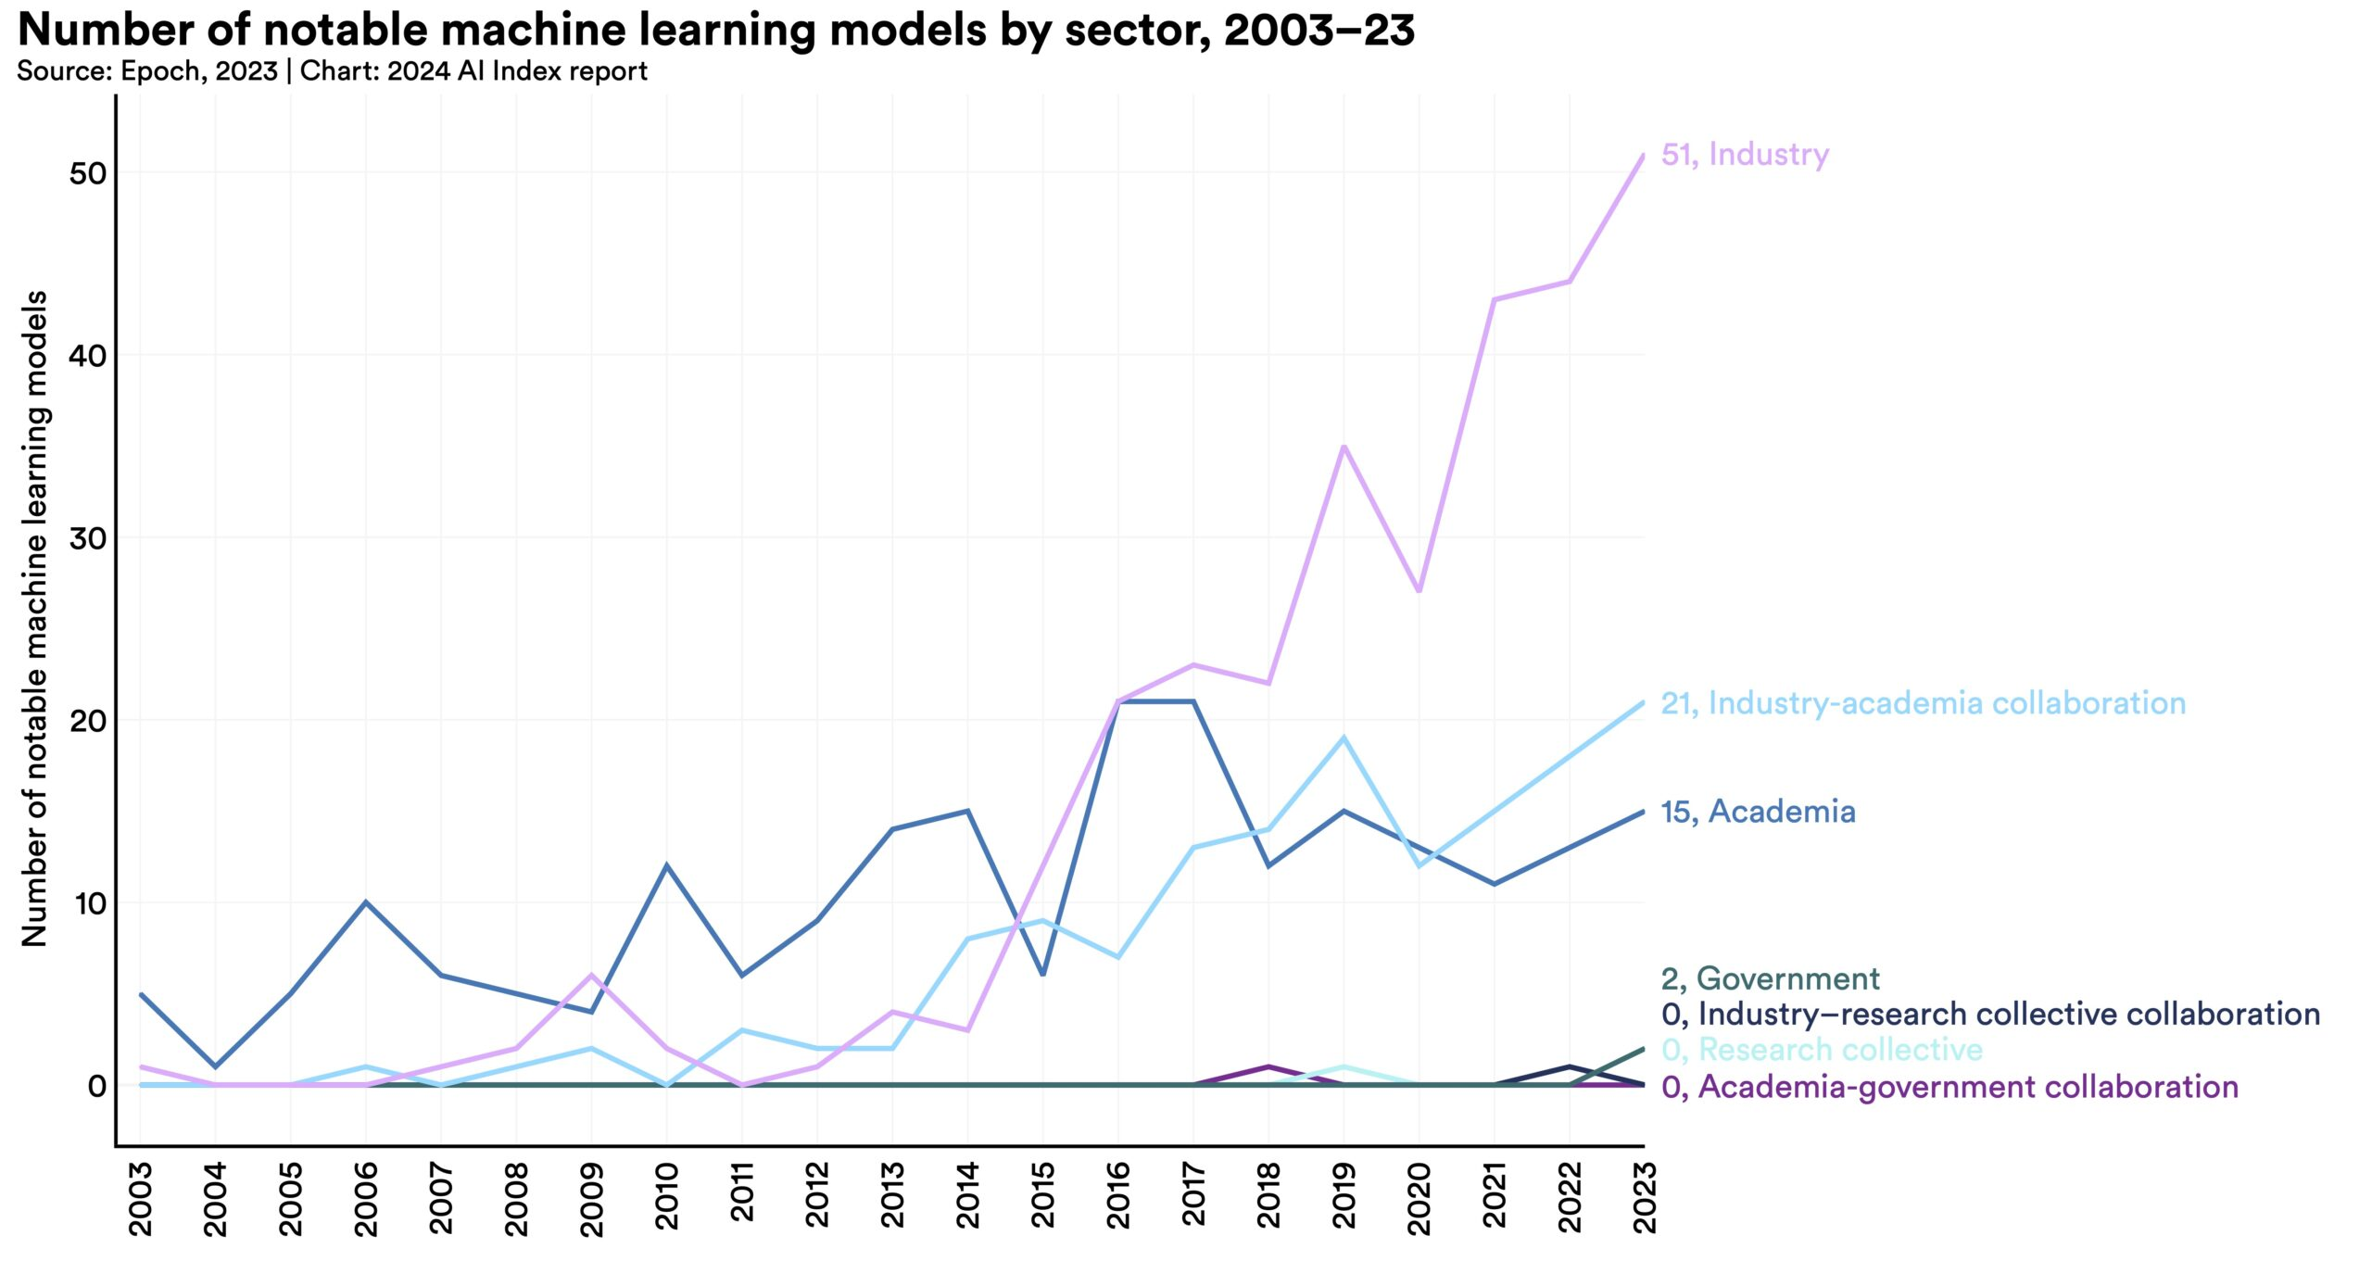
Industry continues to dominate frontier AI research.
In 2023, industry produced 51 notable machine learning models, while academia contributed only 15. There were also 21 notable models resulting from industry-academia collaborations in 2023, a new high.

Slide 51
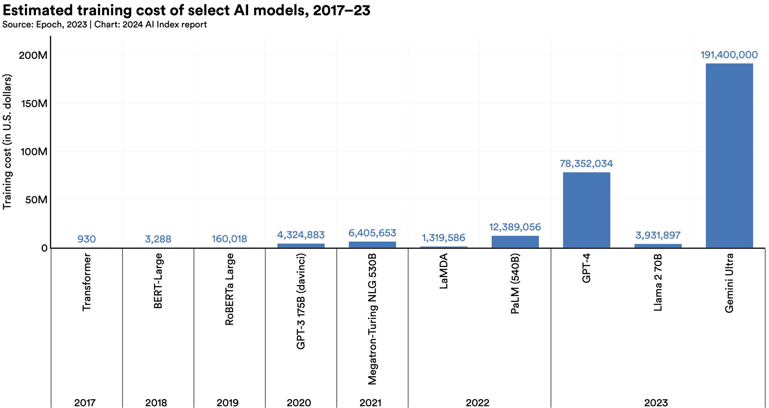
Frontier models get way more expensive.
According to AI Index estimates, the training costs of state-of-the-art AI models have reached unprecedented levels. For example, OpenAI’s GPT-4 used an estimated $78 million worth of compute to train, while Google’s Gemini Ultra cost $191 million for compute.

Slide 52
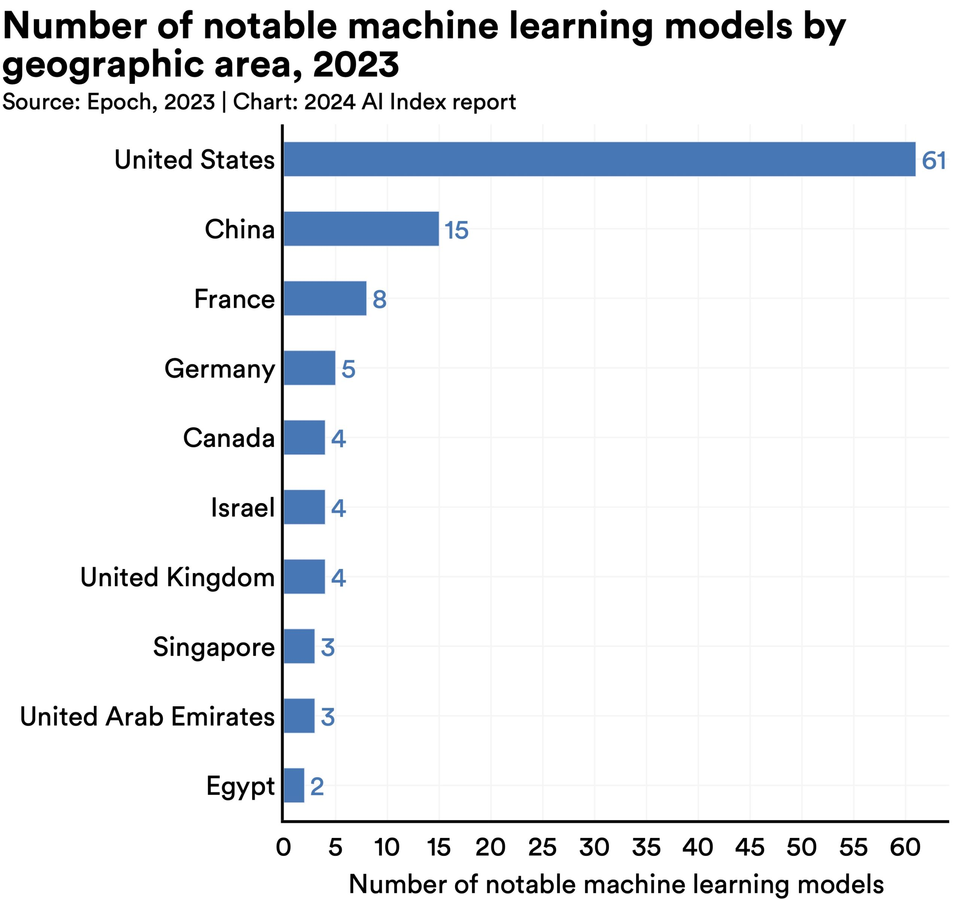
The United States leads China, the EU, and the U.K. as the leading source of top AI models.
In 2023, 61 notable AI models originated from U.S.-based institutions, far outpacing the European Union’s 21 and China’s 15.

Slide 53
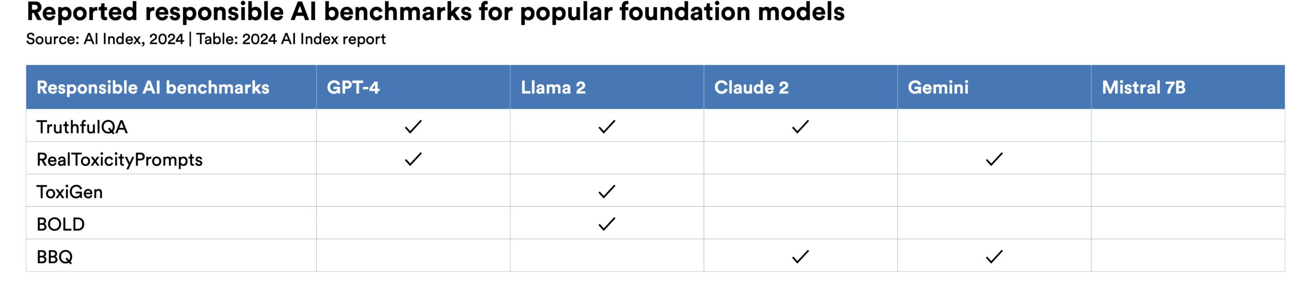
The United States leads China, the EU, and the U.K. as the leading source of top AI models.
New research from the AI Index reveals a significant lack of standardization in responsible AI reporting. Leading developers, including OpenAI, Google, and Anthropic, primarily test their models against different responsible AI benchmarks. This practice complicates efforts to systematically compare the risks and limitations of top AI models.

Slide 54
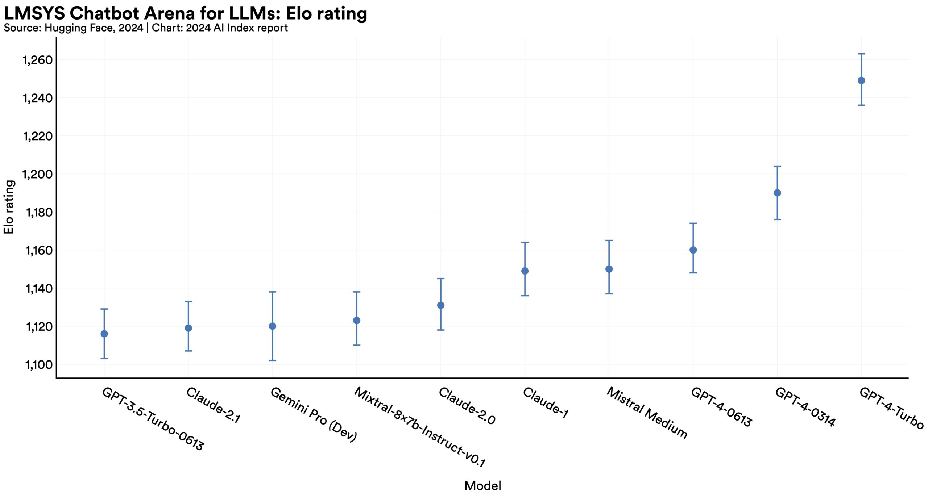

Slide 55
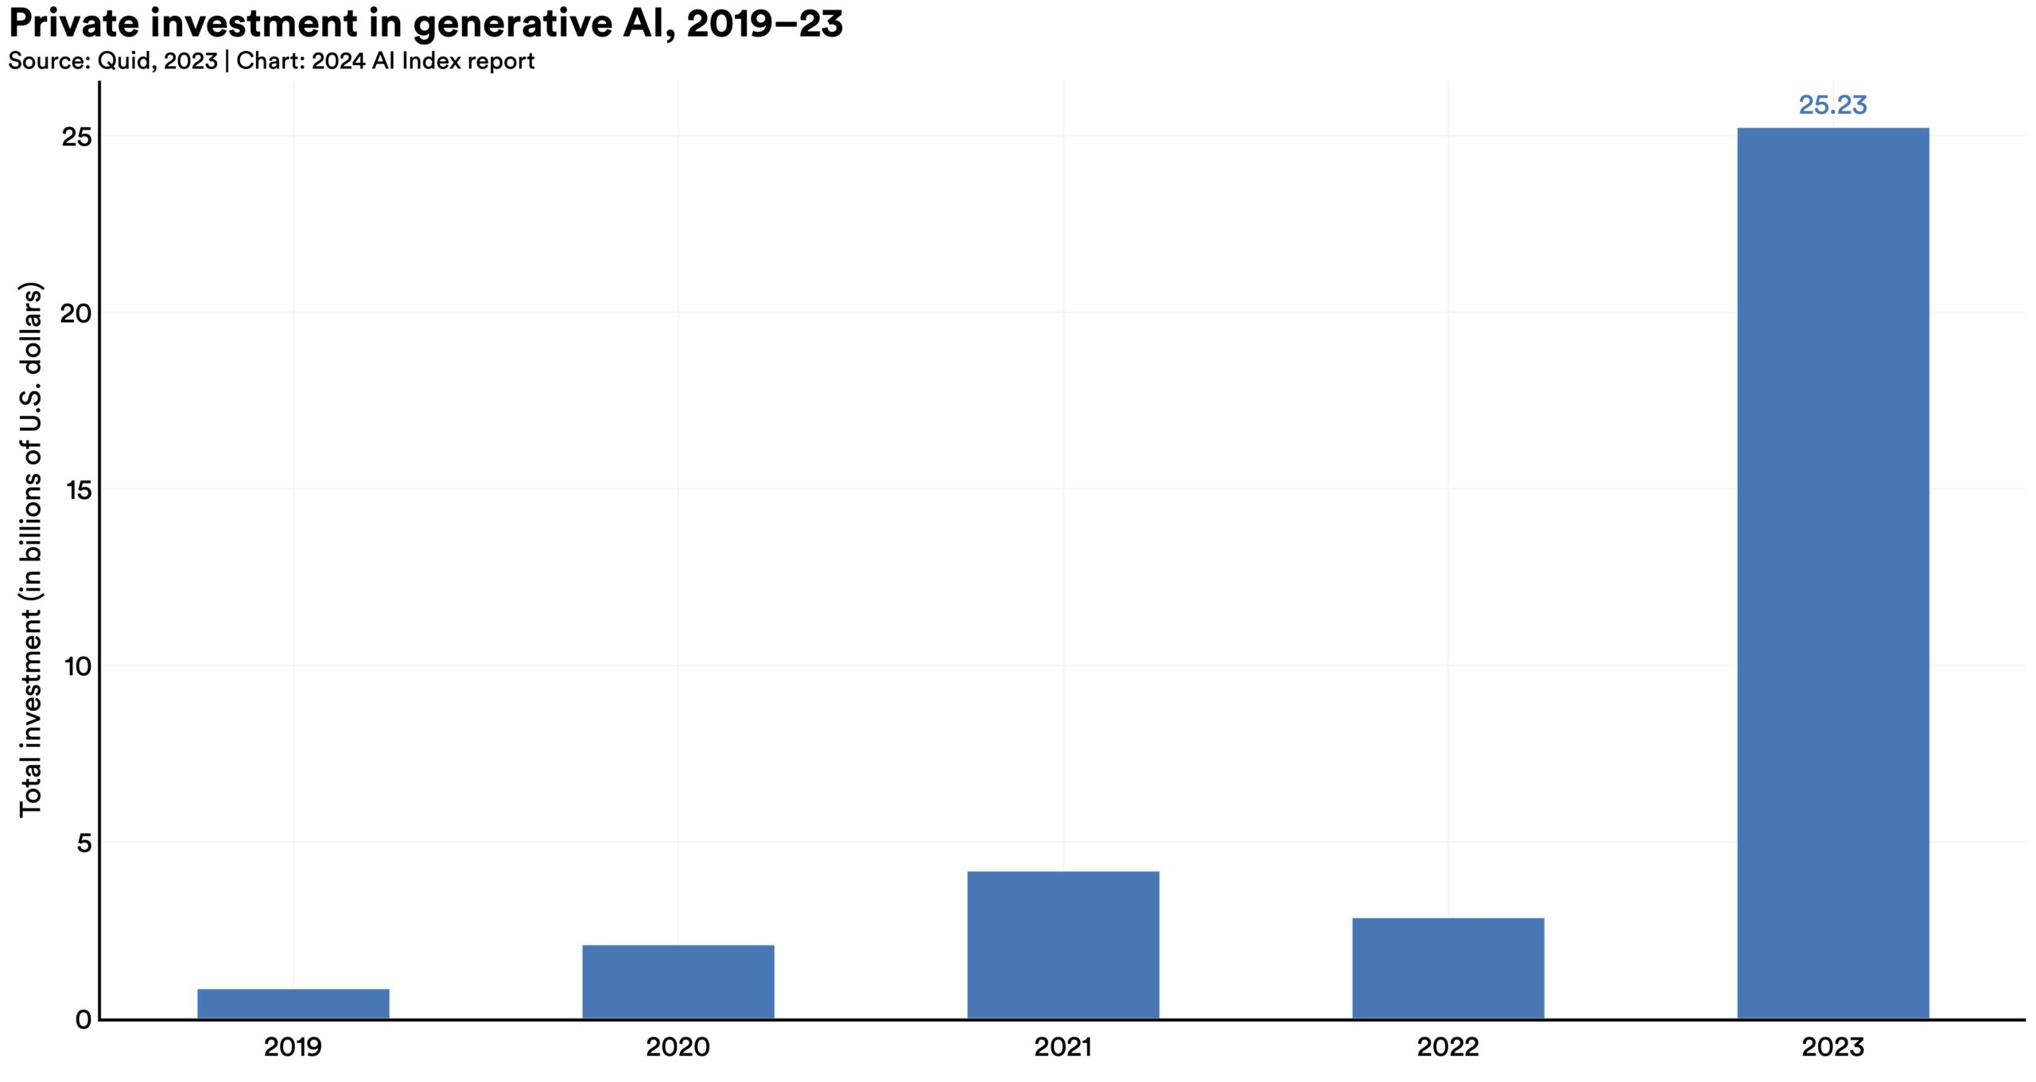
Generative AI investment skyrockets
Despite a decline in overall AI private investment last year, funding for generative AI surged, nearly octupling from 2022 to reach $25.2 billion. Major players in the generative AI space, including OpenAI, Anthropic, Hugging Face, and Inflection, reported substantial fundraising rounds.

Slide 56
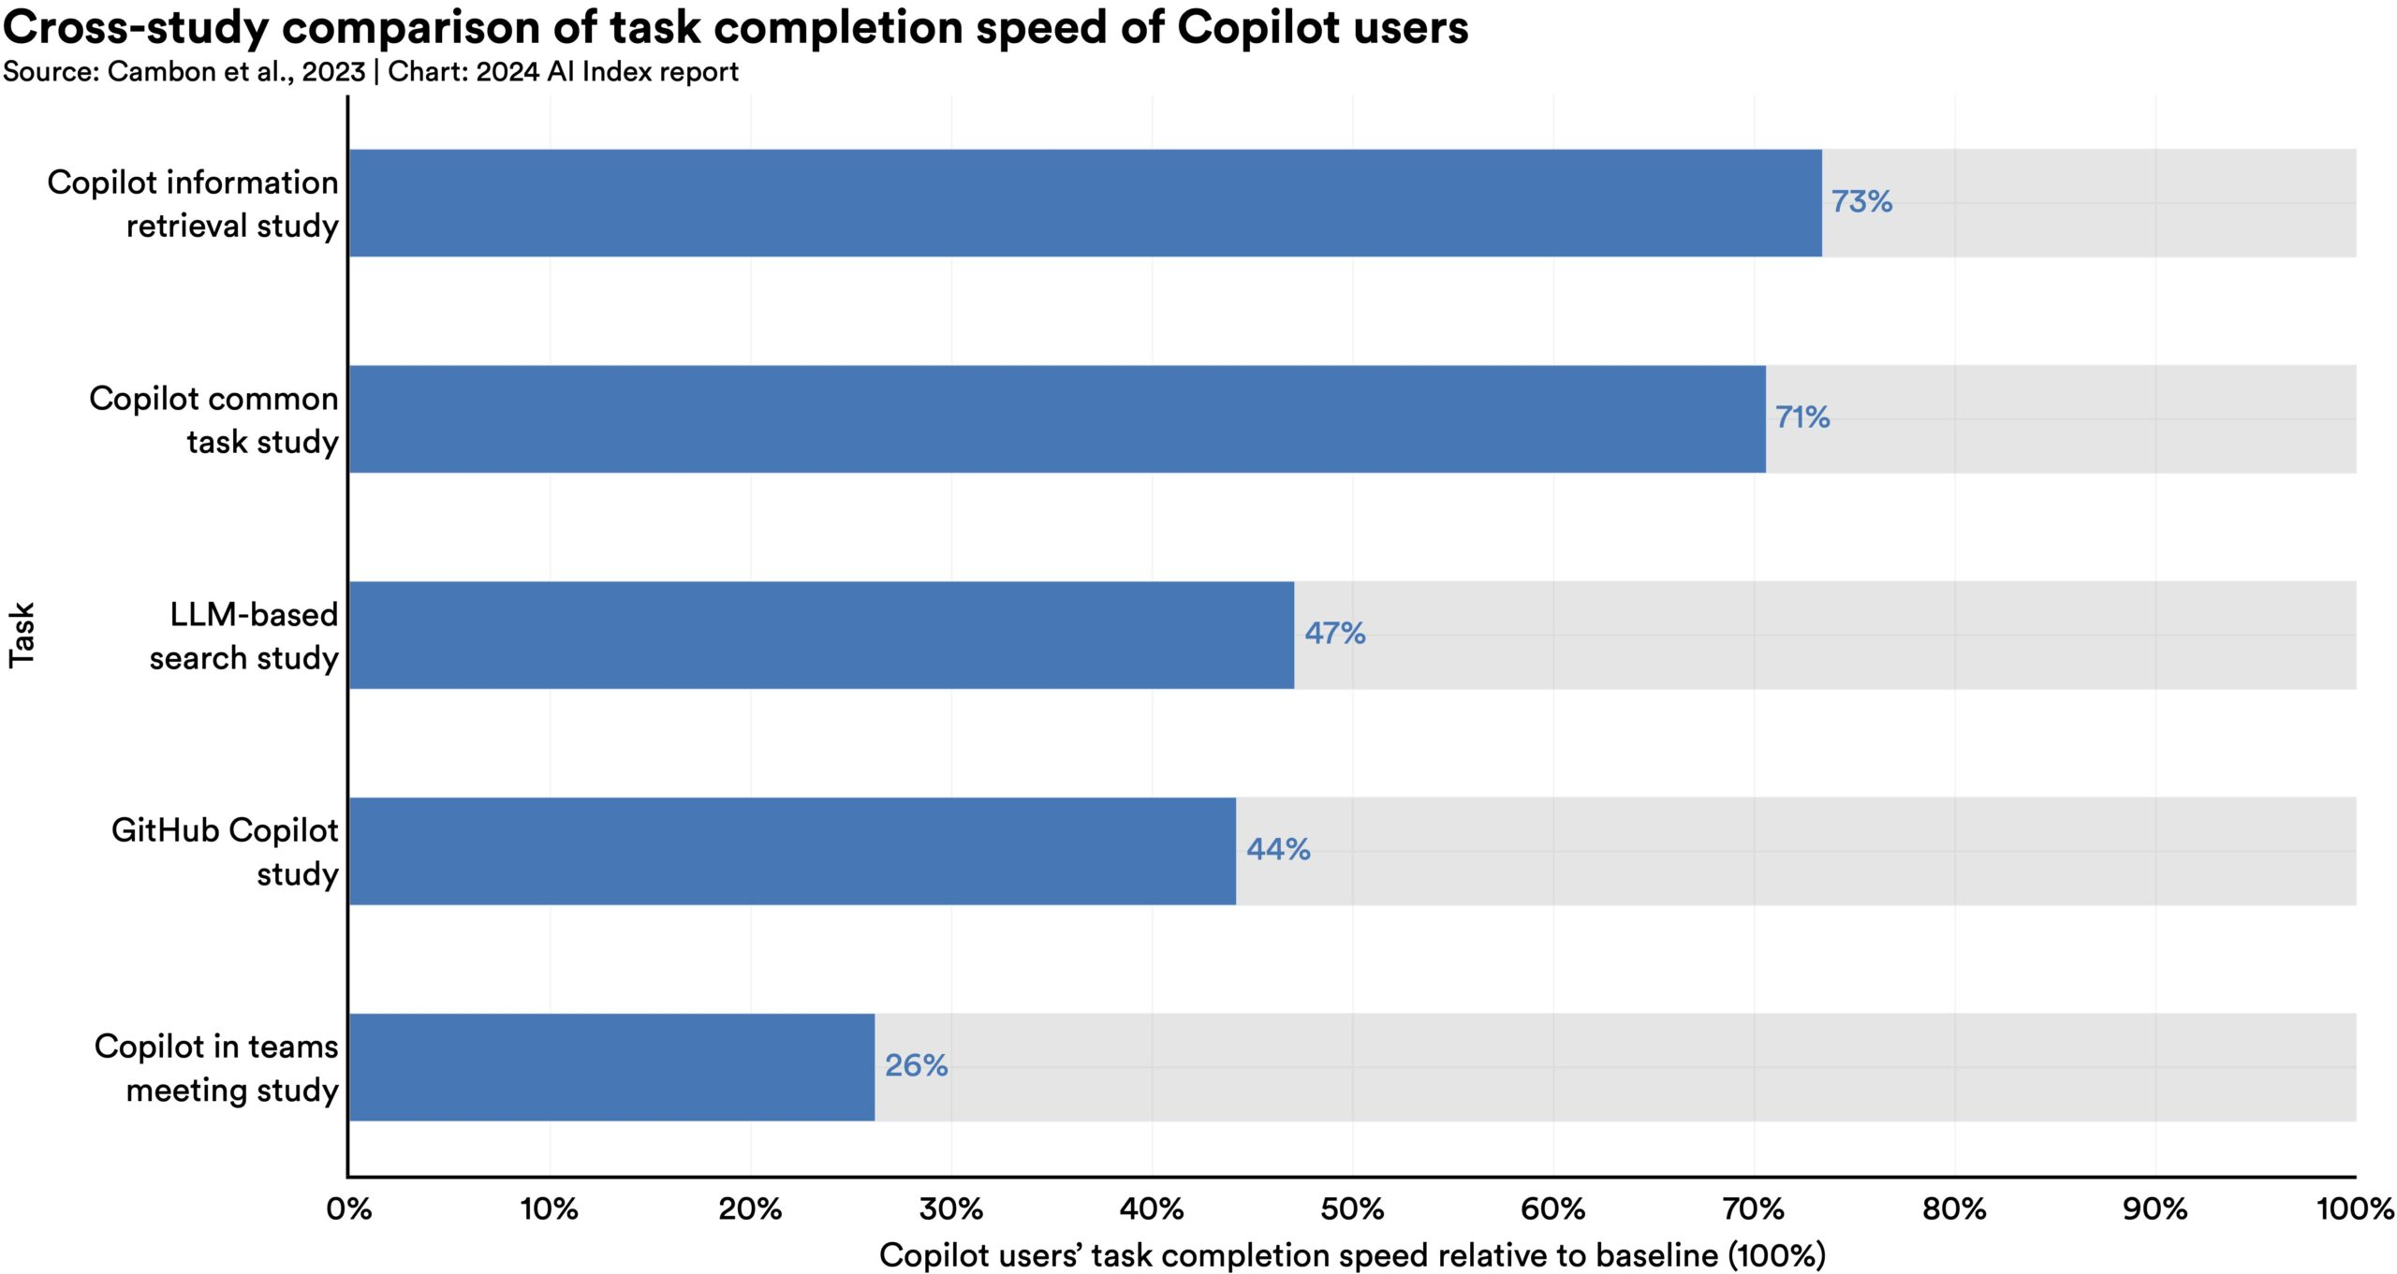
AI makes workers more productive and leads to higher quality work.
In 2023, several studies assessed AI’s impact on labor, suggesting that AI enables workers to complete tasks more quickly and to improve the quality of their output.
These studies also demonstrated AI’s potential to bridge the skill gap between low- and high-skilled workers. Still other studies caution that using AI without proper oversight can lead to diminished performance.

Slide 57
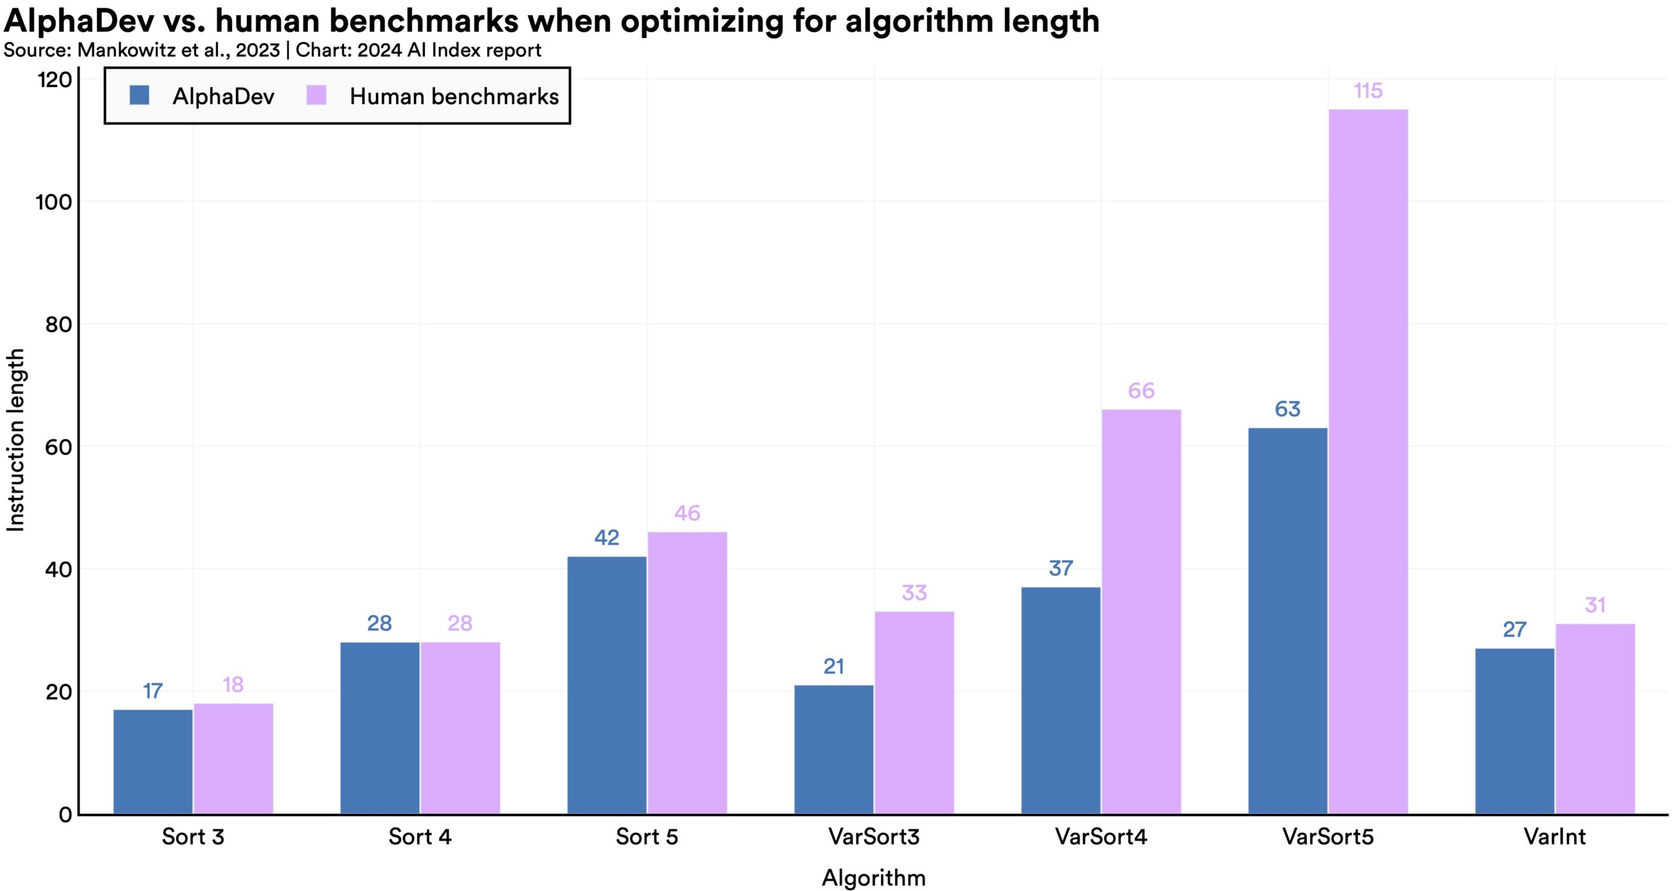
Scientific progress accelerates even further, thanks to AI.
In 2022, AI began to advance scientific discovery. 2023, however, saw the launch of even more significant science-related AI applications—from AlphaDev, which makes algorithmic sorting more efficient, to GNoME, which facilitates the process of materials discovery.

Slide 58
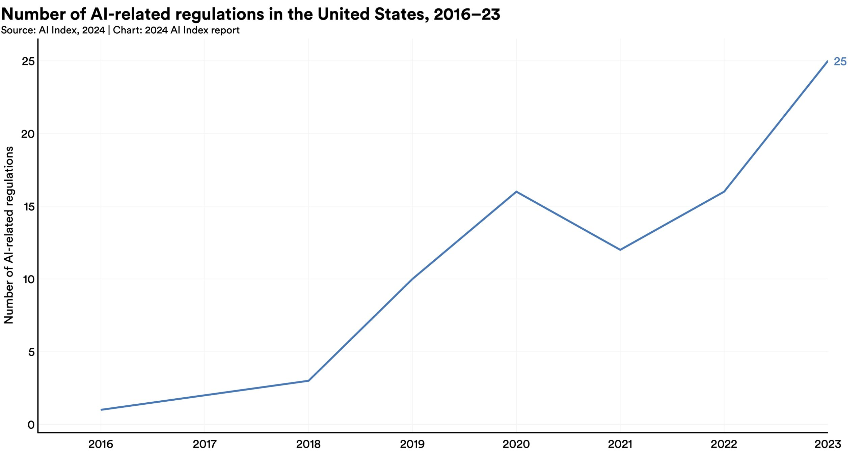
The number of AI regulations in the United States sharply increases.
The number of AI-related regulations in the U.S. has risen significantly in the past year and over the last five years. In 2023, there were 25 AI-related regulations, up from just one in 2016. Last year alone, the total number of AI-related regulations grew by 56.3%.

Slide 59
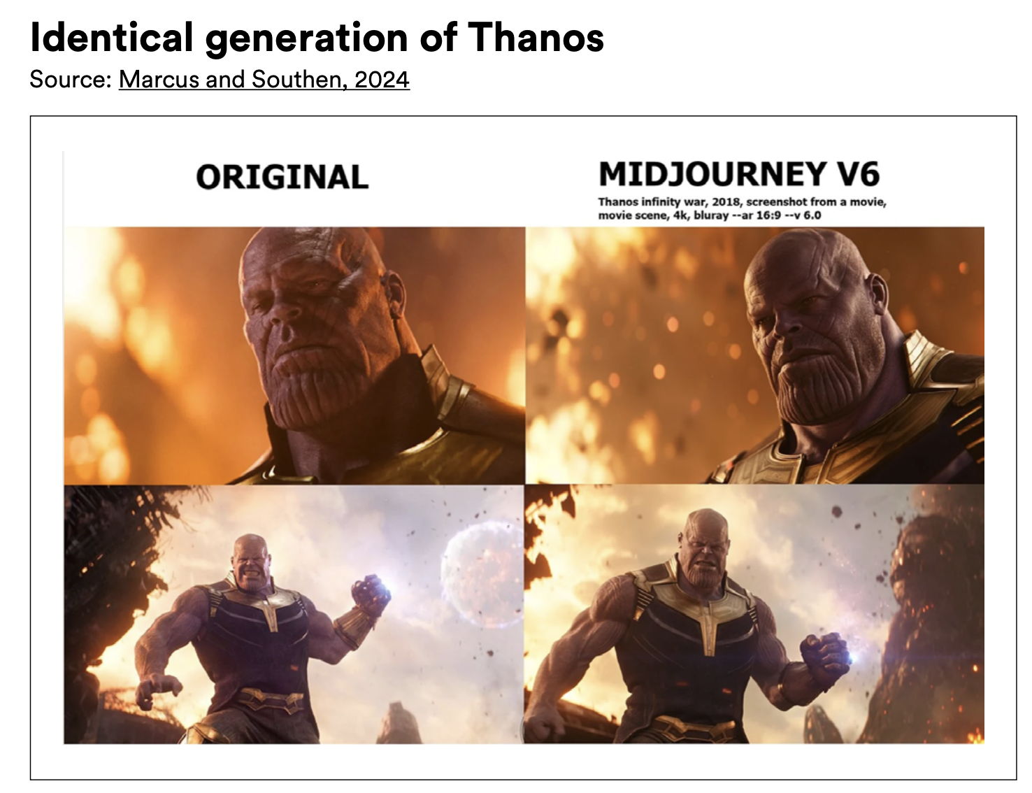

Slide 60
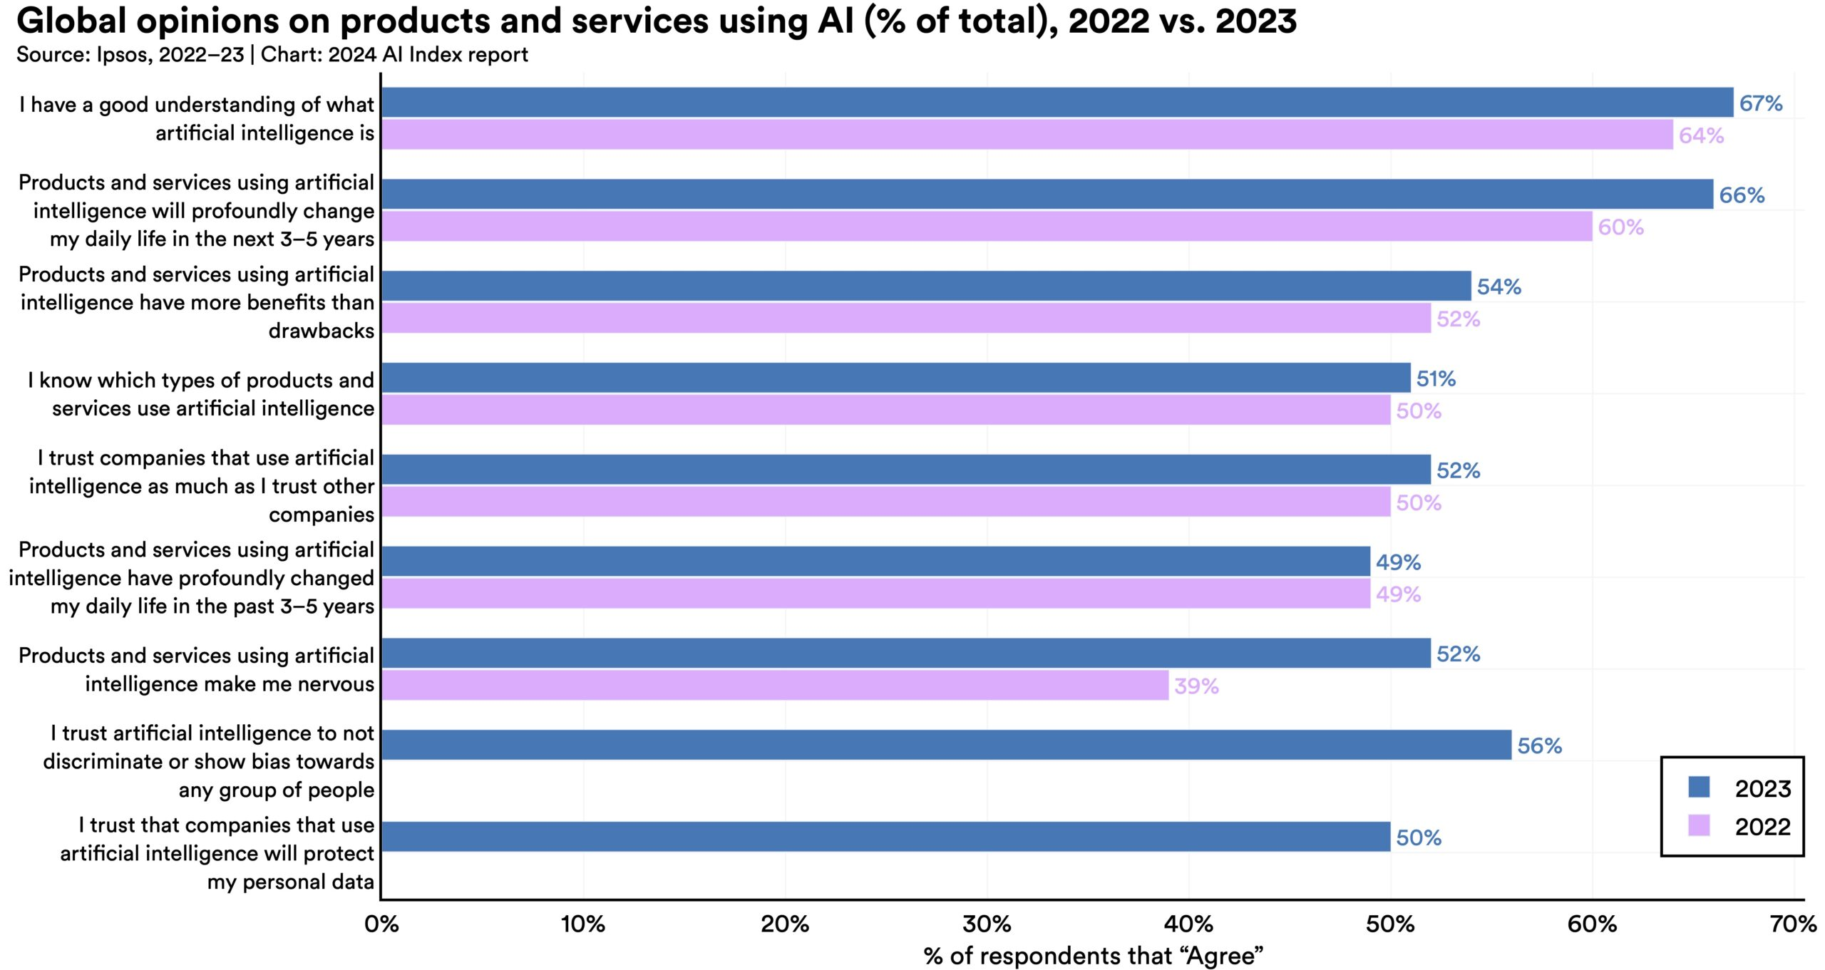
People across the globe are more cognizant of AI’s potential impact—and more nervous.
A survey from Ipsos shows that, over the last year, the proportion of those who think AI will dramatically affect their lives in the next three to five years has increased from 60% to 66%. Moreover, 52% express nervousness toward AI products and services, marking a 13 percentage point rise from 2022. In America, Pew data suggests that 52% of Americans report feeling more concerned than excited about AI, rising from 38% in 2022.

Slide 61

Questions?

Slide 62


